Slide 1
COVID-19 Vaccine Info October 2021
Carbon Medical Service Association
Haven Halk FNP, Russell Scow PharmD,
Michael Smith PharmD, and Jordan Tatton FNP

Slide 2
Why Train?
Understanding COVID-19 Vaccines
Help us respond to patients' questions
Not propagate false information
Help keep us safe
Plan to Share Facts – I respect your opinions
Thank you for the good questions
Please ask more as we go
If disagree with data happy to meet 1:1
Sorry if too simplified or complicated
Personal Bias: pro-vaccine but disagree with mandate

Slide 3
How Bad is COVID-19 Really?
https://www.cdc.gov/mmwr/volumes/70/wr/mm7014e1.htm

Slide 4
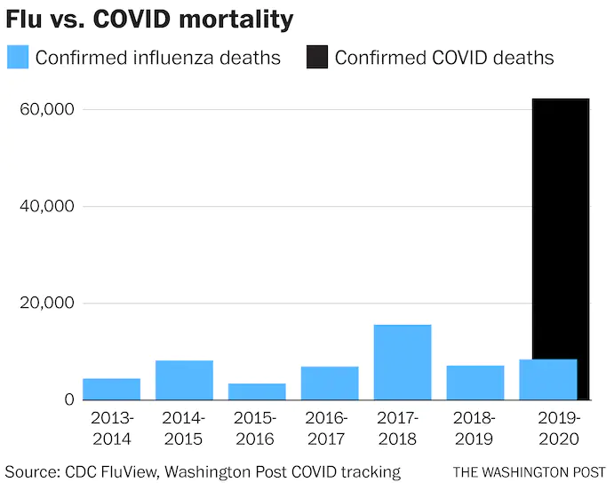
COVID-19 is Like a bad flu, Right?
Data from May 2020
https://www.washingtonpost.com/business/2020/05/02/theres-more-accurate-way-compare-coronavirus-deaths-flu/

Slide 5
How Bad is COVID-19 Really?
Deaths in United States
2020 – 375,000 deaths
2021 – 330,000 deaths in 10 months
Total so far: 705,000
Worldwide Deaths 4.8 Million
https://www.cdc.gov/mmwr/volumes/70/wr/mm7014e1.htm & https://coronavirus.jhu.edu/

Slide 6
How Bad is COVID-19 Really?
https://www.cdc.gov/flu/about/burden/index.html & https://coronavirus.jhu.edu/

Slide 7
How Bad is COVID-19 Really?
https://www.history.com/news/deadliest-events-united-states

Slide 8
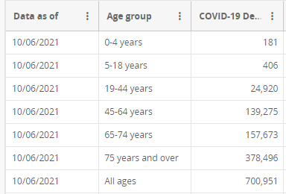
How Age Affects?
https://data.cdc.gov/NCHS/Provisional-COVID-19-Deaths-Focus-on-Ages-0-18-Yea/nr4s-juj3

Slide 9
Sorry for Dark Start
Vaccines Bring Hope

Slide 10
Why Vaccines?
Goal of Vaccines?
Eradication of Virus vs Patient Survival
Animal Reservoirs and Vectors?
https://asm.org/Articles/2020/March/Disease-Eradication-What-Does-It-Take-to-Wipe-out

Slide 11
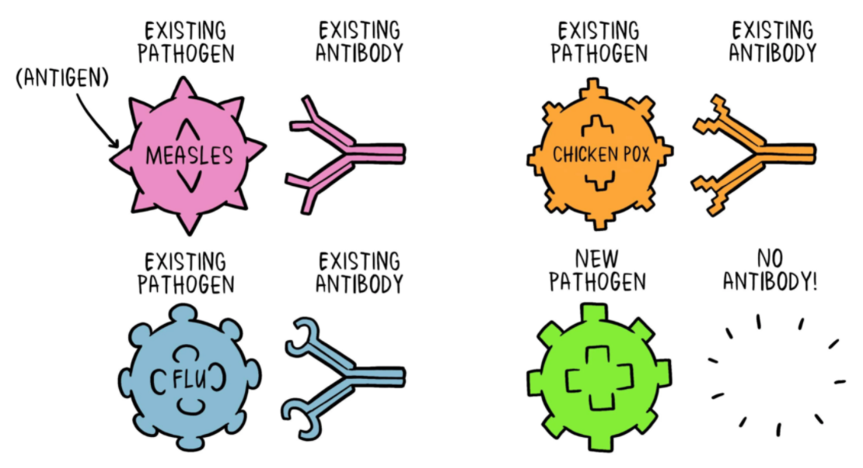
How Vaccines Work
T-Cells
B-Cells
Antigen
Antibody
https://www.who.int/news-room/feature-stories/detail/how-do-vaccines-work

Slide 12
Different types of vaccines
Inactivated – (dead virus)
Flu, Polio, Hep A
Live-attenuated – (alive but weak)
MMR, varicella, yellow fever
Messenger RNA (mRNA) – (info to make protein)
COVID-19 (Pfizer, Moderna)
Not new, studied for decades (flu, Zika, cytomegalovirus)
Subunit, recombinant, polysaccharide, and conjugate vaccines – (Specific piece of a germ)
Hep B, Pneumonia, HPV, Pertussis (P in DTAP), Shingles
Toxoid vaccines – (immunity to harmful product not germ itself)
Diphtheria, Tetanus
Viral vector vaccines – (nonharmful virus delivers instructions for protein)
COVID-19 (J&J)
https://www.hhs.gov/immunization/basics/types/index.html & https://www.cdc.gov/coronavirus/2019-ncov/vaccines/different-vaccines/mrna.html

Slide 13
Developed from aborted tissue?
Human cell cultures are commonly used in research and drug development
Cells altered so can keep multiplying over and over
HeLa – 1950’s cervical cancer patient Henrietta Lacks
WI-38 & MRC-5 –fetus lung cells
Not aborted for purpose of vaccine, but used after mother chose to do in 1960’s
Used to develop: Hep A, MMR, varicella
HEK293 – 1973 Kidney cell of aborted fetus
PER.C6 – 1985 Retinal cell of aborted fetus
https://medicalxpress.com/news/2020-10-fetal-cells-1970s-power-medical.html & https://www.historyofvaccines.org/index.php/content/articles/human-cell-strains-vaccine-development

Slide 14
Developed from aborted tissue?
HEK293 –Pfizer and Moderna development
PER.C6 – J&J development
Do not require nor solicit additional abortions
Vaccines do not contain aborted fetal cells
OTC meds using HEK293 in development:
Tylenol, Advil, Aspirin, Aleve, Sudafed, Benadryl, Claritin, Tums, etc.
Prescription meds using HEK293 in development
Levothyroxine, Atorvastatin, Omeprazole, Albuterol, Lisinopril, Azithromycin, Remdesivir, Ivermectin, etc.
http://publichealth.lacounty.gov/media/coronavirus/docs/vaccine/VaccineDevelopment_FetalCellLines.pdf & https://www.patheos.com/blogs/throughcatholiclenses/2021/01/if-any-drug-tested-on-hek-293-is-immoral-goodbye-modern-medicine/

Slide 15
Concerns with development?
Fast development because of technology developed over last decade
Many companies/governments working simultaneously, lots of funding
 | Clinical Trial Participants
Pfizer | 36,621 ratio 1:1 (12/10/20)
Moderna | 27,817 ratio 1:1 (12/17/20)
J&J | 39,321 ratio 1:1 (2/26/21)

Slide 16
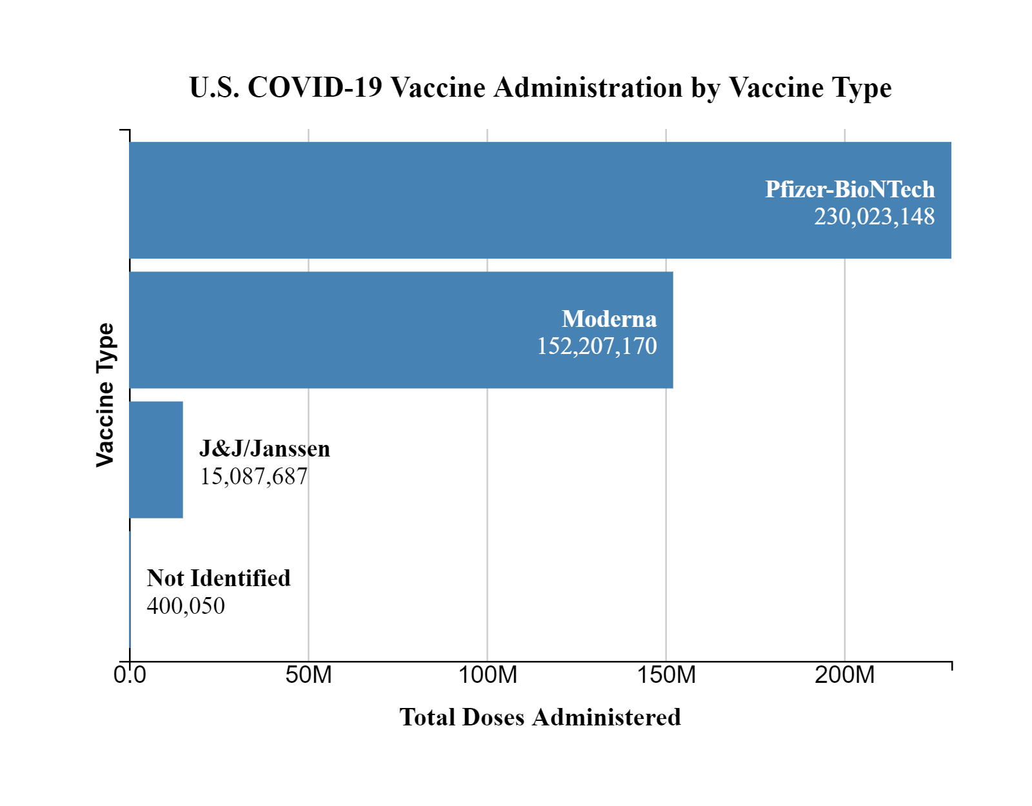
Since Initial Studies?
397 million doses in United States
6 Billion Doses of various vaccines worldwide
https://covid.cdc.gov/covid-data-tracker/#vaccinations_vacc-total-admin-rate-total & https://www.bloomberg.com/graphics/covid-vaccine-tracker-global-distribution/#us

Slide 17
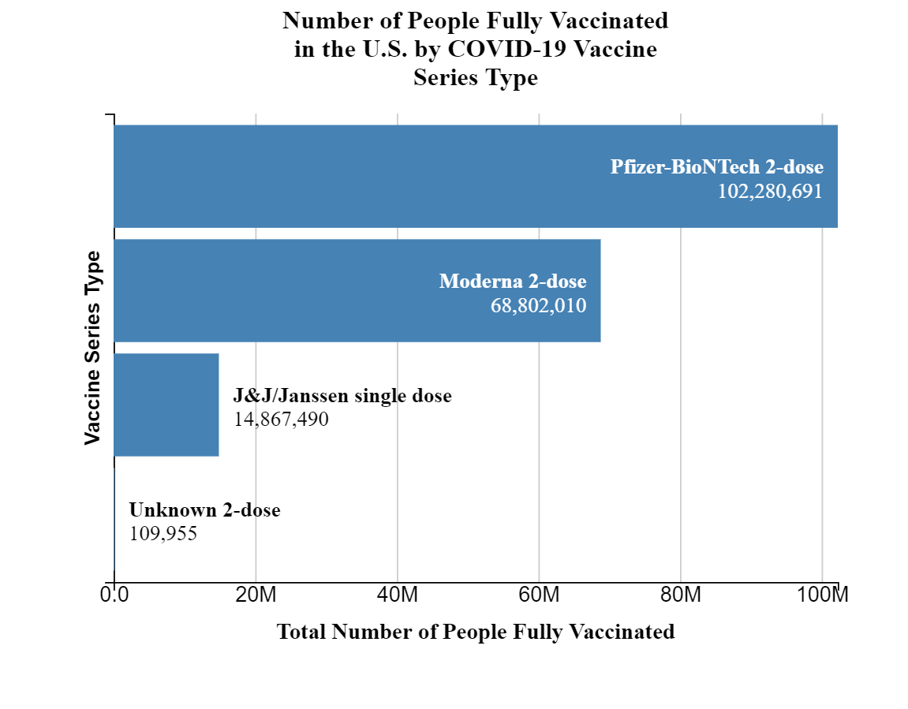
Since Initial Studies?
About 185 million of 331 million Americans are fully vaccinated
https://covid.cdc.gov/covid-data-tracker/#vaccinations_vacc-total-admin-rate-total & https://www.census.gov/library/stories/2021/04/2020-census-data-release.html

Slide 18
Pregnancy and Breastfeeding and the COVID-19 Vaccine
Carbon Medical Service
Information compiled by Russell Scow, PharmD and Haven Halk, FNP

Slide 19
Maternal Concerns are real!
This Photo by Unknown Author is licensed under CC BY-ND

Slide 20
If I want to get pregnant in the future, should I get the vaccine?
In short, YES!
Getting the vaccine now protects your health allowing you to be a healthy mom in the future!
Your antibodies can pass on to your infant protecting them after birth! (More on this later)
Also, there is no need to delay getting pregnant until after you get the vaccine.
The vaccine does not cause infertility.
Wait. What? I heard that it did!
This Photo by Unknown Author is licensed under CC BY-ND

Slide 21
Does the COVID-19 Vaccine cause infertility?
Where did this idea start?
In December 2020 by a German doctor and epidemiologist named Wolfgang Wodarg
What was the concern?
The concern was about a protein called syncytin-1, which shares similar genetic instructions with part of the spike protein of the novel coronavirus. The syncytin-1 protein is an important component of the placenta in mammals, and they worried the vaccine would cause women’s bodies to reject the human placenta.
What do the data say?
The coronavirus spike protein and syncytin-1 share small stretches of the same genetic code, but not enough to make them a match and affect the mammal (including human!) placentas.
Infertility has not been caused by the COVID-19 Vaccine or any previous vaccine!

Slide 22
If I’m pregnant, should I get the vaccine?
In short, YES!
All the national medical organizations strongly support vaccine during pregnancy (ACOG, AANP, AMA, and the CDC, etc.)
But what are the facts?
Pregnant women are at low risk of getting COVID-19 but they are at high risk of severe illness, hospitalization, ICU stay and death if they get it!
According to American College of Gynecology (ACOG): “A growing amount of data confirms that COVID-19 vaccines are safe during pregnancy. Scientists have compared the pregnancies of women who have received COVID-19 vaccines and women who have not. The reports show that these women have had similar pregnancy outcomes. Data do not show any safety concerns.”

Slide 23
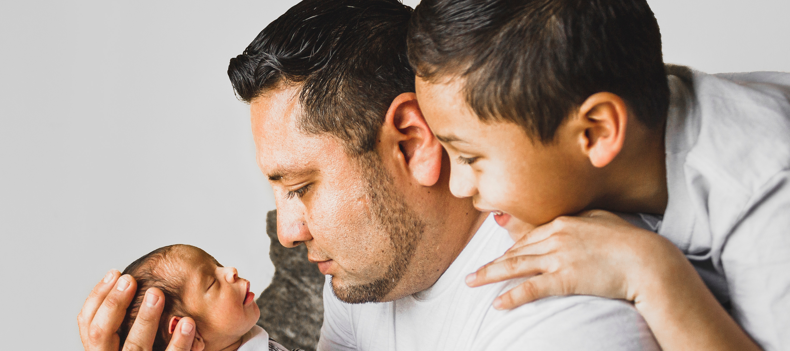
Are there benefits or risks to my baby if I get the vaccine while pregnant?
Women who had the vaccine during pregnancy had higher levels of antibodies than women who had been infected with COVID-19 during pregnancy. This means there was likely a better immune response from the mRNA vaccine than with natural immunity alone.
Antibodies have been found in umbilical cord blood showing the antibodies are capable of crossing to the placenta to confer neonate immunity.
2 doses show better transfer than 1 dose.
AJOG, 2021

Slide 24
But isn’t the vaccine new? Has it been studied?
The mRNA Vaccine have been studied on pregnant women more than any other vaccine to date and the data shows that the benefits significantly outweigh the risks.
Pregnancy Risk Hotline
That said, studies will continue to be on-going, which is as it should be!

Slide 25
Vaccines in pregnancy are not new!
According to the CDC there are 2 other vaccines recommended during pregnancy: Flu and Tdap
Other vaccines are recommended prior to pregnancy.
The following vaccines are advised to be avoided during pregnancy:
HPV, MMR, live flu vaccine, Varicella and some travel vaccines such as yellow fever, typhoid, and Japanese encephalitis

Slide 26
If I’m pregnant, should I get the booster shot?
In short, Yes!
ACOG recommends that if you are pregnant and got the Pfizer vaccine at least 6 months ago you get a booster dose. You can get a booster dose at any time during pregnancy.
This is recommended due to the increased risk for severe disease in pregnant people.
This Photo by Unknown Author is licensed under CC BY-SA

Slide 27
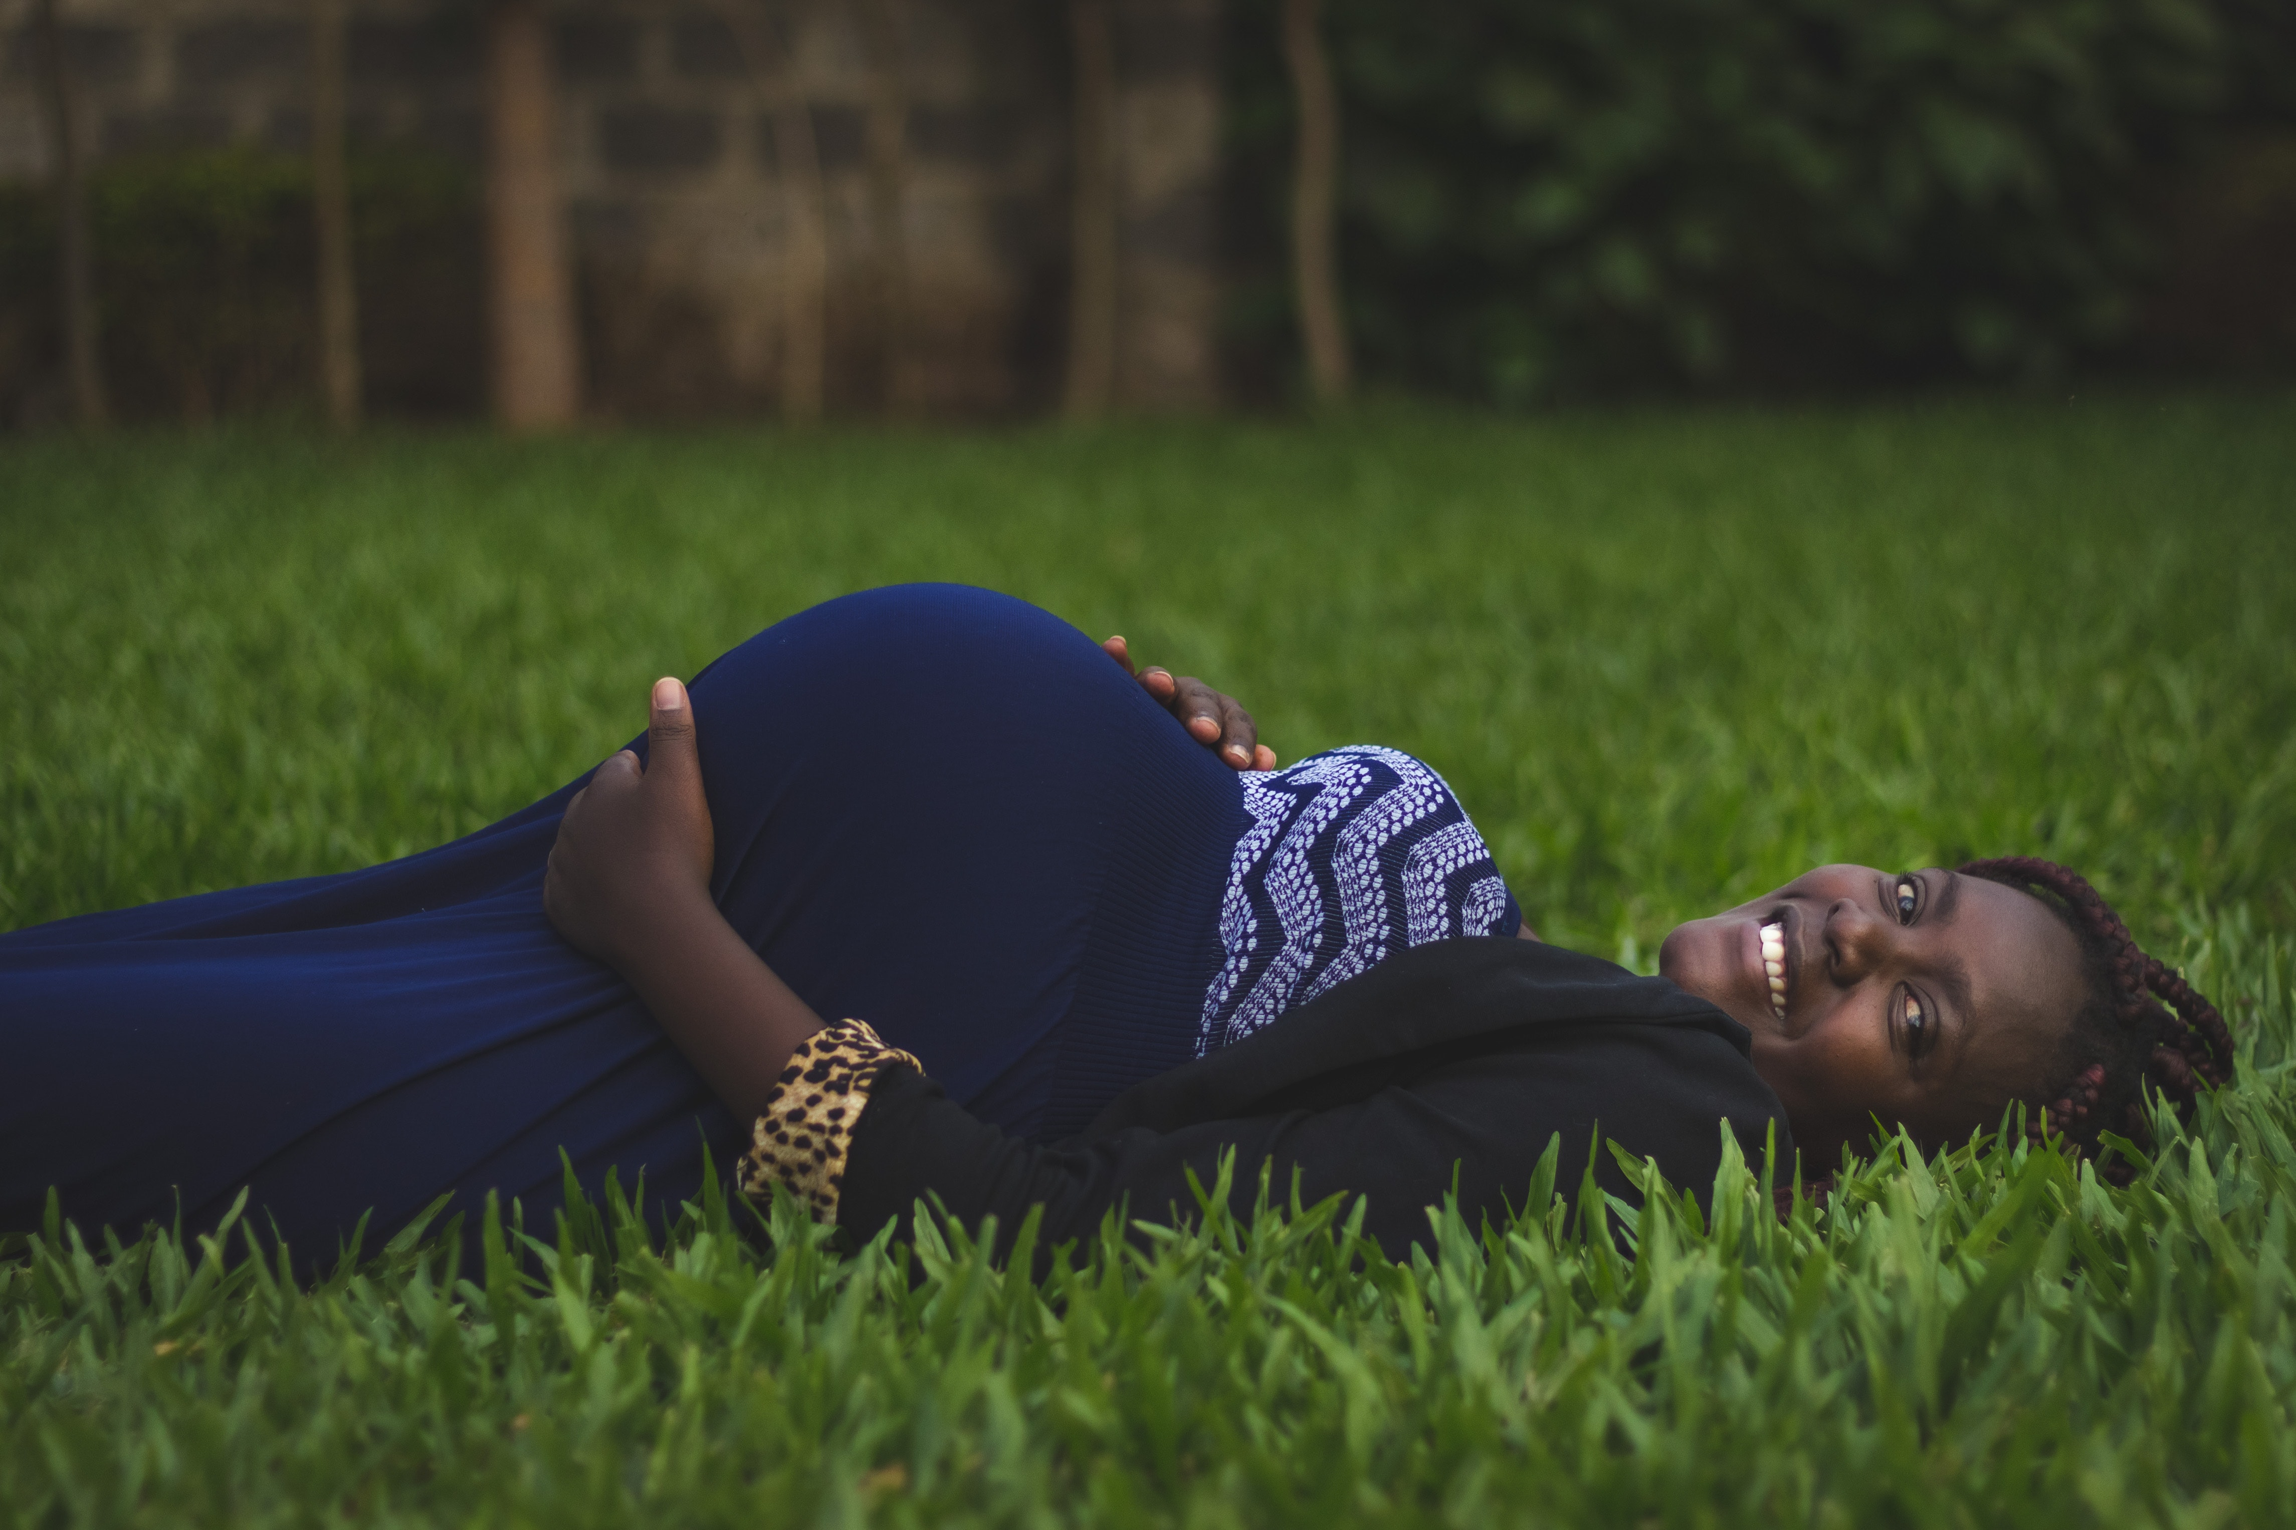
Let’s breakdown the research data!
No safety concerns in pregnancy have been found in animal studies.
No adverse pregnancy-related outcomes occurred during other clinical trials that used the same vaccine platform as the J&J vaccine.
Vaccine does not cause the COVID-19 infection in pregnant people or their babies (or anyone!)
Data on mRNA vaccines are reassuring for no increased risk of miscarriage, early labor, newborn harm.
Pregnant people have not reported different side effects to the vaccines than non-pregnant people.
mRNA vaccine during pregnancy reduces risk of COVID-19 infection.
Antibodies made by the pregnant person were found in umbilical cord blood indicating passing of immune response to the infant.

Slide 28
If I’m breastfeeding my child(ren) should I get the vaccine?
In short, YES!
ACOG recommends that breastfeeding women get a COVID-19 vaccine. There is no need to stop breastfeeding if you want to get a vaccine.
In studies the antibodies created by the mother have been present in breast milk indicating possible immune protection transferred to the infant.
This Photo by Unknown Author is licensed under CC BY

Slide 29
Are there side effects specific to breastfeeding mother & their infants?
Mothers
Infants
In some studies, there was a decrease in breast milk production
This lasted up to 72 hours and resolved without treatment in 100% of the women studied.
All other side effects were the same as the non-breastfeeding population
Some mild irritability was noted in a few of the breastfeeding mother’s infants.
This also resolved quickly and without treatment.
UC. San Diego Health, 2021 & Breastfeeding Medicine, 2021

Slide 30
Questions?
This Photo by Unknown Author is licensed under CC BY

Slide 31
Which COVID-19 Vaccine is Best?
CDC
“All currently authorized and recommended COVID-19 vaccines:
are safe,
are effective, and
reduce your risk of severe illness.
CDC does not recommend one vaccine over another.”
How to Pick ‘Best for You’
https://www.cdc.gov/coronavirus/2019-ncov/vaccines/different-vaccines.html

Slide 32
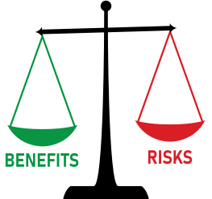
Balance Risk vs Benefit

Slide 33
Pfizer BioNTech (COMIRNATY)
FDA Approved August 23, 2021 for 16+
EUA for age 12-16
mRNA vaccine
2 shots, 21 days apart (full 14 days post 2nd dose)
Immunocompromised 3rd dose 28 days after
Booster 6 months after 2nd shot
Only available at Health Department
Strict cold storage requirements (dry ice)
Relaxed storage requirements with FDA approval
https://www.cdc.gov/coronavirus/2019-ncov/vaccines/different-vaccines/Pfizer-BioNTech.html

Slide 34
Moderna
EUA for ages 18+
In Europe age 12-17 since July
mRNA vaccine
Higher dose than Pfizer, cause higher titers or AE
2 shots, 28 days apart (full 14 days post 2nd dose)
Immunocompromised 3rd dose 28 days after
Not approved for a booster … yet
Most accessible in our area (we give)
Regular freezer temperature – preferred rural
https://www.cdc.gov/coronavirus/2019-ncov/vaccines/different-vaccines/Moderna.html

Slide 35
Johnson & Johnson (Janssen)
EUA for ages 18+
Viral vector vaccine
1 shot (full 14 days post dose)
No booster shot yet … expected soon
Less availability locally but some
Regular fridge temperature
https://www.cdc.gov/coronavirus/2019-ncov/vaccines/different-vaccines/janssen.html

Slide 36
Pfizer Side Effects???
Reaction | After 1st Dose | After 2nd Dose
Local Reaction (Pain, Redness, Swelling, Itching) most mild/mod | 65% | 65%
Fatigue | 29% | 48%
Headache | 25% | 40%
Myalgia (Muscle Pain) | 17% | 37%
Fever, Chills, Fever | Not reported | 20%
Reactions most often day following vaccination
Less frequent among 65+ but still present
Reaction (12-15 yr olds) | After 2nd Dose
Fatigue | 66%
Headache | 65%
Chills | 42%
Myalgia | 32%
https://www.uptodate.com/contents/covid-19-vaccines-to-prevent-sars-cov-2-infection#H2581314898

Slide 37
Moderna Side Effects???
Reaction | After 1st Dose | After 2nd Dose
Local Reaction (Pain, Redness, Swelling, Itching) most mild/mod | 74% | 82%
Fatigue | 33% | 60%
Headache | 27% | 53%
Myalgia (Muscle Pain) | 21% | 51%
Fever, Chills, Fever | Not reported | 40%
Joint Pain | Not reported | 32%
Reactions most often day following vaccination
Local are mostly mild limited to 2 days
Not affect daily activity or require OTC pain meds
Less frequent among 65+ but still present
https://www.uptodate.com/contents/covid-19-vaccines-to-prevent-sars-cov-2-infection#H2581314898

Slide 38
J&J Side Effects???
Reactions most often day following vaccination
Local are mostly mild limited to 2 days
Not affect daily activity or require OTC pain meds
61% One Injection site reaction
76% At least 1 Systemic Reaction
Fatigue, Pain, Headache
Anxiety related events
Increased heart rate, hyperventilation, fainting
https://www.uptodate.com/contents/covid-19-vaccines-to-prevent-sars-cov-2-infection#H2581314898

Slide 39
Very Rare Side Effects
Pfizer and Moderna
Males 12-29 years old
Myocarditis or Pericarditis
41 cases/million (males)& 4.2 cases/million (females)
“Given the infrequency and the mild nature of the myocarditis and pericarditis cases, the benefits of mRNA vaccination greatly exceed the small increased risk” –UpToDate
Blood Clots in review of 500,000+ patients
4 cases/million from vaccine, 39 cases/million from COVID-19
Blood clots 8-10x more likely from COVID-19 than vaccine
Anaphylaxis (Pfizer 5 & Moderna 2.8)/1 million
90% within 30 minutes
80% in people with history of allergic reactions
Bells Palsy – 4 cases total (background rate)
https://www.uptodate.com/contents/covid-19-vaccines-to-prevent-sars-cov-2-infection#H2581314898 & https://www.cidrap.umn.edu/news-perspective/2021/04/study-covid-much-more-likely-vaccines-cause-blood-clots & https://www.cdc.gov/coronavirus/2019-ncov/vaccines/safety/myocarditis.html

Slide 40
Very Rare Side Effects
J&J (and AstraZeneca)
Females 18-49 years old
TTS – Thrombosis and Thrombocytopenia syndrome
8.8 cases/million (3 cases/million overall)
“Regulatory bodies in the United States and Europe have concluded that the population and individual benefits of these vaccines, including reductions in death and critical illness outweigh the risk of these rare events” – UpToDate
Guillain-Barre (7.8 cases/million doses)
Males 50-64 (15.6 cases/million doses)
https://www.uptodate.com/contents/covid-19-vaccines-to-prevent-sars-cov-2-infection#H2581314898 &

Slide 41
How Effective are they?
What does Effective mean?
50 cases instead of 1000 cases in population of 100,000
 | How Effective (Clinical Trials) | How Effective (Real World Data)
Pfizer | 95% Effective 36,621 PCT 1:1 1983 age 12-18 | 92% Effective/97% Death Israel 6.5 million (72% Pfizer)
Moderna | 94.5% Effective 27,817 PCT 1:1 | 91% Effective 40,000 hospital/20,000 urgent 98% Effective in 100,000 veterans
J&J | 66.3% Effective (delta starting) 39,321 PCT 1:1 | 73% ER care, 68% Hospitalization 11,000 hospital/9,000 urgent care
Trial Data attached & https://www.uptodate.com/contents/covid-19-vaccines-to-prevent-sars-cov-2-infection#H1731276181

Slide 42
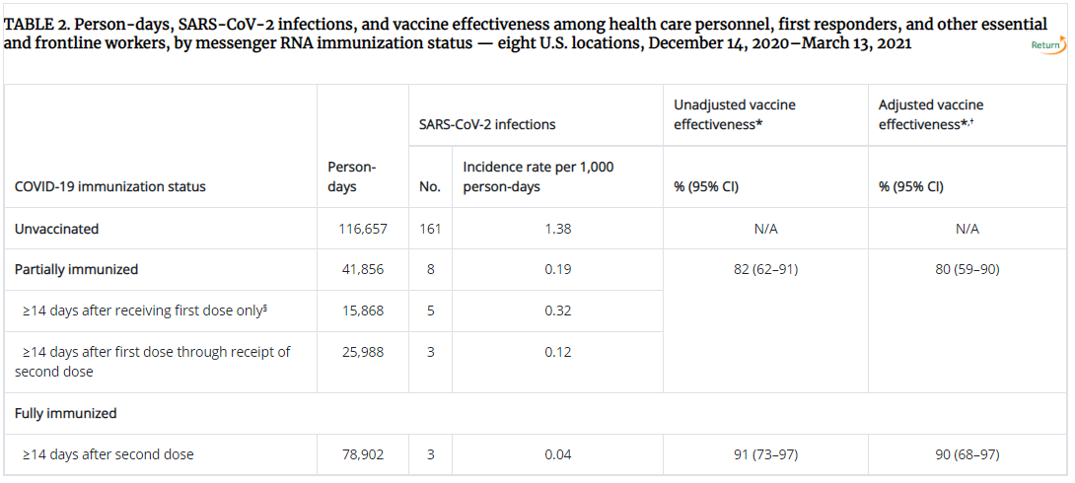
In Health Care Workers?
3950 participants
450 (11.4%) Salt Lake City
https://www.cdc.gov/mmwr/volumes/70/wr/mm7013e3.htm?s_cid=mm7013e3_w

Slide 43
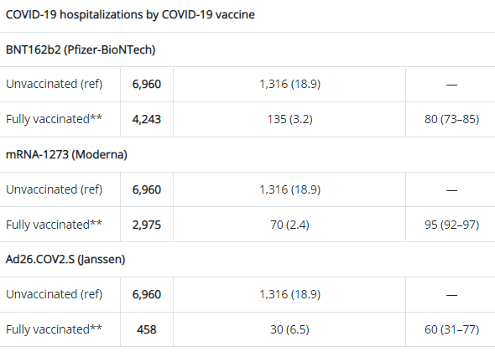
In Preventing Hospitalization?
Including data from
IHC in Salt Lake City, Utah
June – August 2021
https://www.cdc.gov/mmwr/volumes/70/wr/mm7037e2.htm?s_cid=mm7037e2_w

Slide 44
In Preventing Hospitalization?
Similar results in other countries
From January to July 2021
51,281 deaths in EU
Only 256 (0.5%) were in fully vaccinated
https://www.bbc.com/news/health-58545548

Slide 45
COVID-19 AND VARIANTS
Carbon Medical Service
Presented by Michael Smith PharmD, in conjuction with Russell Scow PharmD, Haven Halk FNP, and Jordan Tatton FNP

Slide 46
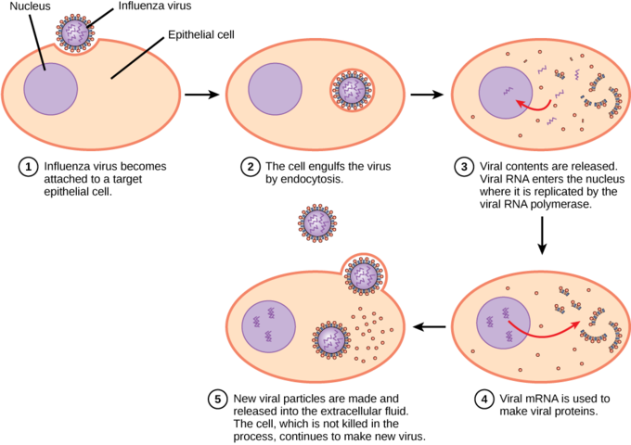
Virus Crash Course – General Information
A virus is a small collection of genetic code, either DNA or RNA, surrounded by a protein coat. A virus cannot replicate alone. Viruses must infect cells and use components of the host cell to make copies of themselves. Often, they kill the host cell in the process, and cause damage to the host organism.
https://www.genome.gov/genetics-glossary/Virus
https://courses.lumenlearning.com/boundless-biology/chapter/virus-infections-and-hosts/

Slide 47
VARIANTS – VIROLOGY 101
WHAT IS A VARIANT?
WHY DO VIRUSES MUTATE?
When a virus makes copies of itself, it sometimes changes a bit. These changes are called mutations. A virus that has mutated is referred to as a variant.
Mutations and variants are very normal for any virus. All viruses change over time – including the virus that causes COVID-19. Most of the time, variants don’t impact how a virus works, or its ability to cause infection and disease. Sometimes however, variants can be more virulent.
Variants may allow a virus to spread more easily, affect how well a person responds to treatment for the virus, impact testing for the virus and how well it is picked-up, reduce the effect of vaccines against the virus, and cause more severe illness from the virus.
One way is by small copying errors in the virus leading to changes in the virus' surface proteins, which sit on the outside of the virus. These proteins want to attach to your cells (much like boats seeking to tie to a dock). These changes result in more closely related virus variations, like the new COVID-19 variants.
In the other way, two variations infect the same cell in a person's body and combine to form a new or "novel" virus. This often happens when a variant that only infects animals comes into contact with a human variant. This version of mutation could have created the novel coronavirus which causes COVID-19.
- https://www.astrazeneca.com/what-science-can-do/topics/covid-19/understanding-viral-variants.html
- https://www.covidvaccinefacts.org/questions/how-do-viruses-mutate

Slide 48
TYPES OF VARIANTS
Scientists monitor all variants but may classify certain ones as Variants Being Monitored, Variants of Concern, Variants of Interest or Variants of High Consequence based on how easily they spread, how severe their symptoms are, and how they are treated.
Variants Being Monitored (VBM)
Include: Alpha, Beta, Gamma, Epsilon, Eta, Iota, Kappa, Mu, Zeta
Include variants for which there are data indicating a potential or clear impact on approved or authorized medical countermeasures or that has been associated with more severe disease or increased transmission but are no longer detected or are circulating at very low levels in the United States, and as such, do not pose a significant and imminent risk to public health in the United States.
Variant of Interest (VOI)
Currently none
A variant with specific genetic markers that have been associated with changes to receptor binding, reduced neutralization by antibodies generated against previous infection or vaccination, reduced efficacy of treatments, potential diagnostic impact, or predicted increase in transmissibility or disease severity.
Variant of Concern (VOC)
Delta
A variant for which there is evidence of an increase in transmissibility, more severe disease (e.g., increased hospitalizations or deaths), significant reduction in neutralization by antibodies generated during previous infection or vaccination, reduced effectiveness of treatments or vaccines, or diagnostic detection failures.
Variant of High Consequence (VOHC)
None
A variant of high consequence has clear evidence that prevention measures or medical countermeasures (MCMs) have significantly reduced effectiveness relative to previously circulating variants.
https://www.cdc.gov/coronavirus/2019-ncov/variants/variant-info.html

Slide 49
COMMON QUESTIONS/CONCERNS WITH REGARD TO VARIANTS
IF I AM VACCINATED, AM I PROTECTED AGAINST VARIANTS?
Yes. The current vaccines offer protection from the current variants. More data is being released and studied to see if booster doses of each vaccine are appropriate to maintain strong immune responses or are needed.
Are variants caused by vaccinated people?
No. Variants occur normally in viruses, and every virus mutates differently.
In general, the more a population is vaccinated, the fewer chances a virus has to mutate.
ANY OTHER QUESTIONS OR CONCERNS???

Slide 50
Breakthrough Cases?
As of April 30th, 2021
10,262 breakthrough infections had been reported to the CDC
among 101 million fully vaccinated individuals
10% Hospitalized
2% Died
27% Asymptomatic
All studies presented show some deaths in vaccinated group
https://www.uptodate.com/contents/covid-19-vaccines-to-prevent-sars-cov-2-infection#H1731276181

Slide 51
Booster Doses?
Do not know what will be expected with mandate
Studies show waning effect over time
Estimate losing half of antibodies every 108 days
After 6-7 months, 90% goes to 70% Effectiveness
Only approved in Pfizer Vaccine to date
Adults 65 +
Adults 50+ and Comorbidities
Adults 18-50 and Comorbidities (MAY GET)
Adults aged 18 to 64 years who have occupational or institutional risk of exposure (MAY GET)
Not applicable to Moderna & J&J … yet
Expect data in coming weeks (FDA meets Oct 14,15, and 26)
Side Effects increased with second doses, no data on boosters
https://www.cdc.gov/coronavirus/2019-ncov/vaccines/different-vaccines/Pfizer-BioNTech.html & https://www.nature.com/articles/d41586-021-02532-4

Slide 52
Vaccines for Kids?
In USA Pfizer for ages 12-18
Europe Moderna also for ages 12-17
Submitted to FDA in June
Pfizer turned in data to FDA September 28, 2021
Data on 2000+ kids ages 5-11
Expect it to take weeks to review
Some speculate vaccines for kids as early as Halloween
More than ¼ of weekly national cases are in kids less than 18 years old
https://www.nbcnews.com/news/us-news/pfizer-seeks-fda-authorization-covid-vaccine-children-ages-5-11-n1279939

Slide 53
I had COVID-19, do I need a shot? How long do I have to wait?
Just as studies show immunity wanes after vaccine, same happens after COVID-19 infection
Evidence emerging that vaccine is better
2.34 times more likely to get reinfected after COVID-19 infection versus vaccinated
(246 case control patients)
When to get vaccine after COVID-19 infection?
After completion of isolation/resolved (10 days)
After exposure – get after quarantine
https://www.cdc.gov/coronavirus/2019-ncov/vaccines/faq.html?s_cid=11572:vaccine%20after%20covid:sem.ga:p:RG:GM:gen:PTN.Grants:FY21

Slide 54
Politics and Vaccines?
In beginning Urban vs Rural rates were equal
Starting in May 2020 rural rates grew faster
1.8% of those tested positive had died
Also higher rate of deaths in rural areas
USU Study in August 2021 (May-Mar)
Political views affect attitudes/actions
Biggest factor linked to case counts was Politics
Biggest factors to death counts were poverty, minority status, lower education levels
“Understanding and coping with a disease should not be political.”
https://www.usu.edu/today/story/recent-study-shows-connection-between-political-views-and-covid-19-rates & https://onlinelibrary.wiley.com/doi/full/10.1111/ruso.12404

Slide 55
COVID-19 and Flu?
Moderna is working on a booster dose combined with a flu shot
You can get both at same time
Initially recommended a 2-week waiting period but now recognize giving both at same time is fine
One study shows flu shot may help minimize ICU stay with COVID-19 (even without COVID-19 vaccination)
More to come
https://www.mercurynews.com/2021/10/06/should-you-get-your-covid-19-booster-and-flu-shots-together/ & https://www.sciencedaily.com/releases/2021/08/210804123547.htm

Slide 56
Any Questions???
I’m sure we went way over time by this point sorry.
I realize some of these conversations are best had in a private setting.
I am happy to schedule my lunch break or any other time to discuss concerns with anybody.
Thanks!!!
https://www.cdc.gov/coronavirus/2019-ncov/vaccines/different-vaccines/Pfizer-BioNTech.html

