Slide 1
340B Pricing Impact of Lower Costing Insulin

Slide 2
Insulin Pricing Changes
Insulin manufacturers publicly announced drops in list price (and institutes patient OOP cap)
Eli Lilly: Humalog and Humulin list prices cut 70% (Q4 2023); non-branded Lispro $25/vial (May 2023); Rezvoglar $92 (April 2023)
Sanofi (Jan 2024): Lantus list price cut 78%; Apidra list price cut 70%
Novo Nordisk (Jan 2024): Novolog list price cut 75%; Novolin and Levemir list price cut 65% (Levemir to be discontinued in 2024)
Policy pressures to decrease list price: 340B inflation penalty, removal of Medicaid cap (Jan 2024), IRA inflation rebates (2022/2025)

Slide 3
Impact to 340B Pricing Calculation
Insulin pricing is currently penny priced based on CPI-U Penalty; without this penalty, the 340B Price will be based upon a discount from AMP or best price (assuming there are contracted price points)
Impact: insulin penny pricing likely to go away rather suddenly by July 2024

Slide 4
340B Ceiling Price Timing
Quarterly pricing
340B prices change quarterly
Manufacturers upload to authorized wholesalers 15–30 days prior to beginning of a quarter
340B pricing lags Medicaid by two quarters

Slide 5
Case Study: Insulin Lispro (Lilly)
New lower WAC price for Lilly’s insulin lispro effective May 2023
Q3 2023 340B pricing = $0.01
Q4 pricing:
WAC = $25
340B = $22.96

Slide 6
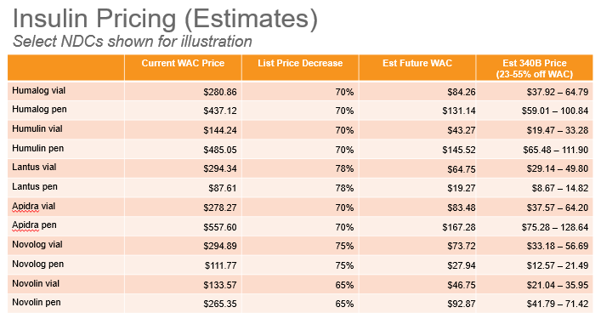
What does this mean?

Slide 7
Resulting Potential Losses
Potential hit: If we dispense one box of each of these insulins one time for a total of 12 prescriptions.
 | Current WAC Price | List Price Decrease | Est Future WAC | Est 340B Price | New WAC Price | Approximate Current 340B Margin | Estimate of new 340B Margin |  | Estimate of new 340B Margin
 |  |  |  | (23-55% off WAC) | Available
Humalog vial | $280.86 | 70% | $84.26 | $37.92 – 64.79 | Yes | $300.00 | $46.34 | to | $19.47
Humalog pen | $437.12 | 70% | $131.14 | $59.01 – 100.84 | Yes | $550.00 | $72.13 | to | $30.30
Humulin vial | $144.24 | 70% | $43.27 | $19.47 – 33.28 | Yes | $100.00 | $23.80 | to | $9.99
Humulin pen | $485.05 | 70% | $145.52 | $65.48 – 111.90 | Yes | $300.00 | $80.04 | to | $33.62
Lantus vial | $294.34 | 78% | $64.75 | $29.14 – 49.80 | Yes | $300.00 | $35.61 | to | $14.95
Lantus pen | $87.61 | 78% | $19.27 | $8.67 – 14.82 | Yes | $500.00 | $53.00 | to | $22.25
Apidra vial | $278.27 | 70% | $83.48 | $37.57 – 64.20 | Yes | $300.00 | $45.91 | to | $19.28
Apidra pen | $557.60 | 70% | $167.28 | $75.28 – 128.64 | Yes | $600.00 | $92.00 | to | $38.64
Novolog vial | $294.89 | 75% | $73.72 | $33.18 – 56.69 | Yes | $300.00 | $40.54 | to | $17.03
Novolog pen | $111.77 | 75% | $27.94 | $12.57 – 21.49 | Yes | $600.00 | $76.85 | to | $32.25
Novolin vial | $133.57 | 65% | $46.75 | $21.04 – 35.95 | Yes | $150.00 | $25.71 | to | $10.80
Novolin pen | $265.35 | 65% | $92.87 | $41.79 – 71.42 | Yes | $300.00 | $51.08 | to | $21.45
 |  |  |  |  |  | $4,300.00 | $643.01 | to | $270.03
 |  |  |  |  |  | Potential loss of | ($3,656.99) | to | $ (4,029.97)

Slide 8
Important Dates to Remember
January 2024-
Potential insurance company reimbursement decreases for insulin due to drop in WAC
340B pricing still in effect
July 2024
Loss of current penny pricing for insulin products impacted by decreases in WAC

Slide 9
What does this look like?

Slide 10
Winners and Losers
Winners: Private cash pay patients – Lower cost of insulin
Loser: Patients on the sliding scale program (Low income/ no income)
Loser: Organizations participating in the 340B program (FQHC’s, FQHC-LA, Hospitals, etc.)
Loser: Potential impacts on patient outcomes (UDS)
Loser: Loser: Drug manufacturers due to loss of revenue
Loser: Patient assistance programs- potential to lose these with lower revenue to MFR
(Opinion)
Big Winners: Insurance companies

Slide 11
Solutions?
Uh….???
Possibly re-purposing Utah’s Insulin Law???
What do you have?

