Slide 1
340B Self Audits

Slide 2
This is an open discussion presentation: The only dumb question is the one not asked!

Slide 3
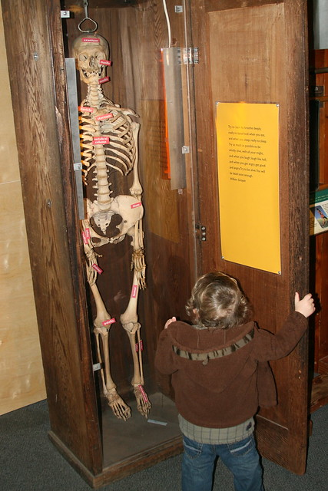
Why Self Audit?
If you do not, then who will?
Who do you want to know your dirty laundry?
HRSA or You?
What do you do with your dirty laundry?

Slide 4
Amount of Liability with 340B
100%
Covered Entity:
Your Vendor:
Zero

Slide 5
Lets Begin: Goals
Goals:
Identify key areas of compliance for a successful self audit program
Examine what happens during an OPA audit and identify areas of potential understanding for your 340B program
Provide OPAIS tips and tricks for navigation and understanding
Describe an audit readiness team and identify responsible individuals and their functionality

Slide 6
Self Auditing
Treat yourself as HRSA/OPA would treat you.
Are you true to yourself when it comes to self auditing?
How much wiggle room do you give yourself?
Do you know yourself as well as you think?
Who has had a procedure change in the last 6 months?
How many of your procedures have changed in the last 6 months?

Slide 7
Question
You are conducting a review of your 340B program and find a prescription for 6 boxes of insulin that was qualified inadvertently. (You pick the reason why it does not qualify.) This review has been conducted 2 weeks after the prescription dispense date. Where do you go from here?
Same Question: Instead of 2 weeks. We are now 8 weeks out. Do you do anything differently?
Same Question: Instead of 2 weeks, we are now out 6 months. Do you do anything differently?
What dictated your responses?

Slide 8
Policies and Procedures
Why?
HRSA needs these for a lot of reasons. The biggest is it provides a template for how your 340B program runs.
Question: How many of your 340B policies run exactly as your Policy and Procedures are written?
Optional: Have a over arching policy that is approved by the board or governing organization. Then have a procedure that you can change/edit with the details showing how to enact the policy.

Slide 9
P&P’s
What are we looking for?
340B Program enrollment recertification and change
Locations where 340B drugs are dispensed or prescribed
OPAIS accuracy and changes: Who reviews, what is reviewed, how often, conforming to Medicaid question
340B recertification
Accurate records
***What is your time frame for how long you keep your records?***
Registration of new site or contract pharmacy

Slide 10
P&P’s
Patient Eligibility/Definition
How does your organization define a 340B eligible patient?
Site
Patient Status
Records
Provider eligibility
**A whole different subset**
Services in scope
Medicaid status

Slide 11
P&P’s
Prevention of Duplicate Discounts
***This is a statute provision***
Carve- in or Carve-Out FFS
Medicaid Managed Care
Contract Pharmacies
340B Program Roles and Responsibilities
Essentially who is responsible for what
340B program education and Competency
“340B organizations receive money from the 340B program, they should be using some of that money to train their staff”

Slide 12
P&P’s
Inventory Management
Procurement and management of inventory
Physical 340B only
Physical 340B and Non-340B separated
Virtual aka neutral inventory
Hybrid: Physical and virtual used
Filters for replenishment from an 11 digit replenishment
Wasted 340B medication
**Inventory Management ties into diversion, another statutory requirement**

Slide 13
P&P’s
Contract Pharmacy Operations
Contracts all contain the 12 contract pharmacy essentials?
Contract for each site
Registration of contract pharmacy prior to the use of 340B drugs
Replenishment model and filters
340B verification of new prescription and filters
Bill to ship to arrangements
Verification of quantity ordered
Wrong NDC shipped
Reconciliation of when the relationship goes bad with the contract pharmacy
Auditable records
Carve-in vs Carve-Out

Slide 14
P&P’s
340B Noncompliance and Material Breach
Define materiality
Define thresholds
What constitutes materiality?
Manufacturer resolution of non-compliance
340B Compliance Monitoring/Reporting
Internal audit plan
Accuracy of information at all sites
MEF, Purchasing through dispensation
Records of audit

Slide 15
P&P’s
Contract Pharmacy Oversight and Monitoring
Maintaining 340B compliance a integrity at the contract pharmacy
Routine reviews
Rx origin, date, patient eligibility, services in scope of grant, medical record, provider eligibility, 11 digit NDC match, Medicaid billing
External independent audits
Must have
340B eligibility, 340B registration, documented P&P’s at CE
Inventory: ordering through dispensation with records
Review of Medicaid exclusion file
Testing sample claims
Mechanisms to demonstrate compliance with state Medicaid billing
340B Oversight Committee reviews audit results
Maintenance of records

Slide 16
OPA Audit
Timeline:
Pre-Audit:
Engagement Letter
Data Request List (DRL)
Onsite Audit: Usually 2 days
Opening Meeting
Review the nuts and bolts of your organization
Policies and Procedures
Personnel interviews
Key people: AO and PC, Pharmacy Staff, Billing Staff, Medical Staff, Vendors (generally through you)
Data Sample Review
Post Audit
Submission of preliminary report to HRSA
HRSA sends final report
Corrective Action Plan (CAP) if needed

Slide 17
The Dreaded DRL: What does it tell us?
What is the DRL?
The Data Request List
Policies and Procedures
Registration and recertification
340B OPAIS
Site Eligibility
Purchasing Process
Exclusions to outpatient drugs
Covered entity oversite of Contract pharmacies
340B Inventory or accumulation
Prevention of Diversion at covered entity and at all pharmacies
Prevention of Duplicate Discounts at covered entities and all pharmacies
How and when to disclose noncompliance
Definition of eligible site for special circumstances (Covid-19, flooding, having a ram knock down your front door and proceed to attack you)

Slide 18
Don’t Laugh it has happened before!

Slide 19
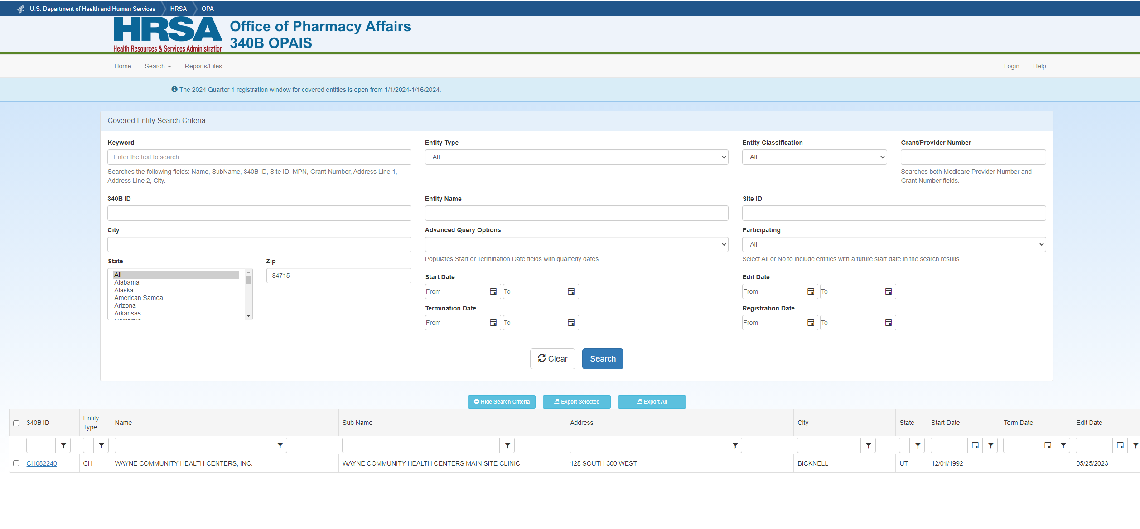
Lets look at OPAIS

Slide 20
DRL
Eligibility
List of locations where services are provided. (Form 5-B)
Notice of Grant Award, FQHC-LA designation or FQHC 638 compact
340B Universe
How was it obtained
Crosswalk with headers
List of all 340B drugs administered or dispensed to patients ( usually 6 months worth sometimes 9!) with all data elements
***Hint: Make this organized and easy to sort. Nobody likes a grumpy auditor.***

Slide 21
DRL
Provider list
Names
NPI
Contracted or employed
**Hint: How do you deal with floating providers?**
Purchasing Documentation
List of all accounts (i.e.. Wholesale account #111222 = 340B ID CH999111)
Copy of one invoice for each account
List of CE’s and Pharmacies that order drugs
**Hint: Match account with names, address, 340B ID**

Slide 22
DRL
Contract Pharmacy Documentation
List of all CE’s contract pharmacies
List of each Agreement and any amendments
***HINT: Do not send in unexecuted contracts! Make sure they are signed***
***HINT: Make sure they cover all of the appropriate sites & pharmacies***
Statement on Letterhead from the organization that conducted the last independent audit
Provide documentation of any audit performed during sample period
List of all Medicaid FFS BIN and PCN numbers that are carved out
List any pharmacy that is not registered as a contract pharmacy and dispensing 340B drugs (Entity owned)
List of pharmacies used from the beginning of the sample period through the last date of the onsite/remote audit.
Note: This is when the audit ends.
Notes:
List of contract pharmacies: Does your list match what is accurate? Do you contracts match your list? (Spreadsheet identifying the contract pharmacies on the contract matching the contract pharmacies listed on OPAIS)

Slide 23
DRL
Self Disclosure Documentation
Medicaid Billing Documentation
All STATES and provider numbers
Example of Medicaid FFS claim for each CE site
From each pharmacy not listed as a contract pharmacy as well
Combined purchasing and distribution model (if applicable)
i.e. central fill
If a re-audit
All documentation showing how you fixed the problems

Slide 24
Lets look at the MEF

Slide 25
MEF

Slide 26
MEF

Slide 27
MEF
Control-F

Slide 28
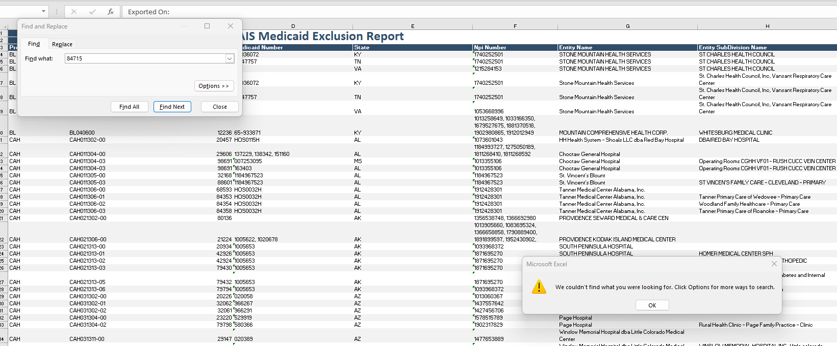
Pop Quiz:
Why can you not find your health center? Is this a bad thing?

Slide 29
Answer to every 340B question there is.
It depends!

Slide 30
Lets look at the Medicaid Exclusion File
Common Problems:
Type-O’s
Transposed numbers, wrong numbers
Listing only your Medicaid Provider Number
Both clinic and pharmacy numbers may be needed depending on your model
NOT listing all of the states that you bill FFS claims to
You have changed your billing practice and not updated your OPAIS status
FQHC’s providing 340B meds but are listed as carve out
Answering “no” when your in-house pharmacy carves in but the site carves out
Submitting claims under one NPI/MPN where one site carves-in and another site carves-out and MEF question are answered the same

Slide 31
What do they know about you?
Pre-Site Visit Call
Information giving or Information gathering?

Slide 32
Important Dates
Audit Letter Engagement Date: (When the Audit Begins)
Pre-Site Visit Call Date
Onsite Audit Dates
Final submission Date

