Slide 1
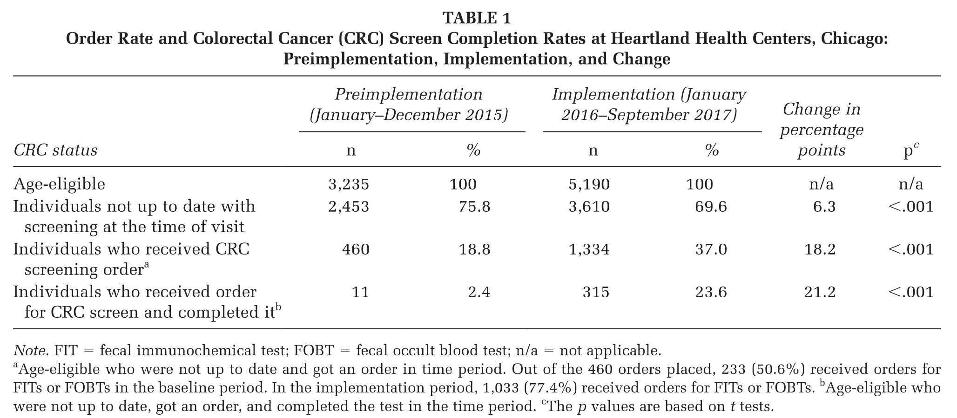
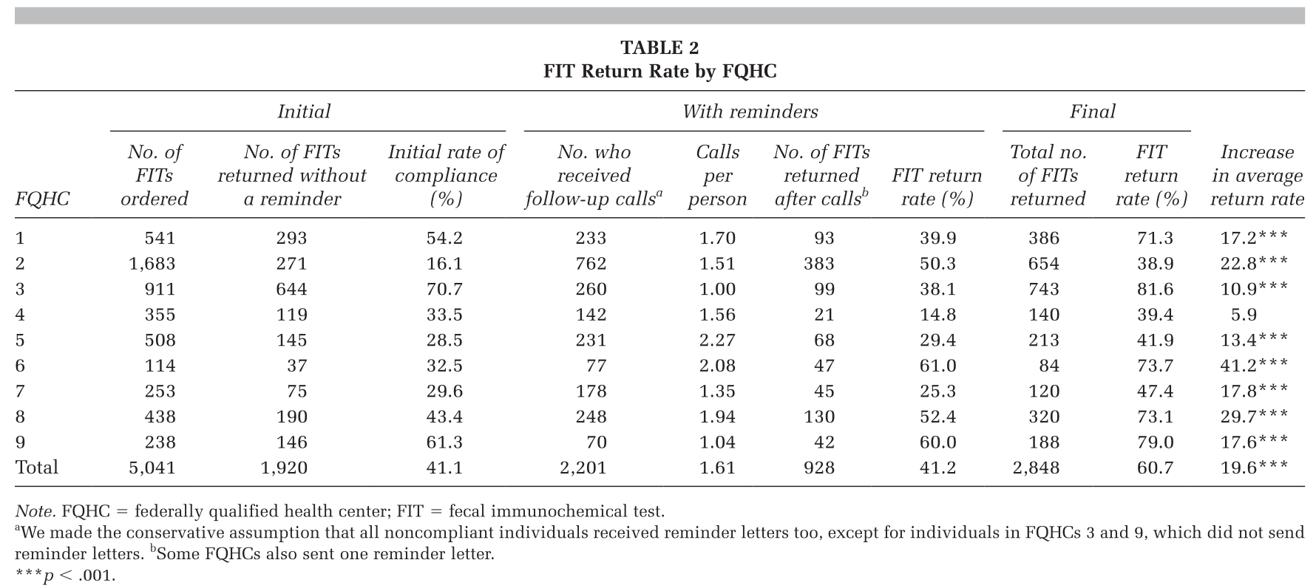
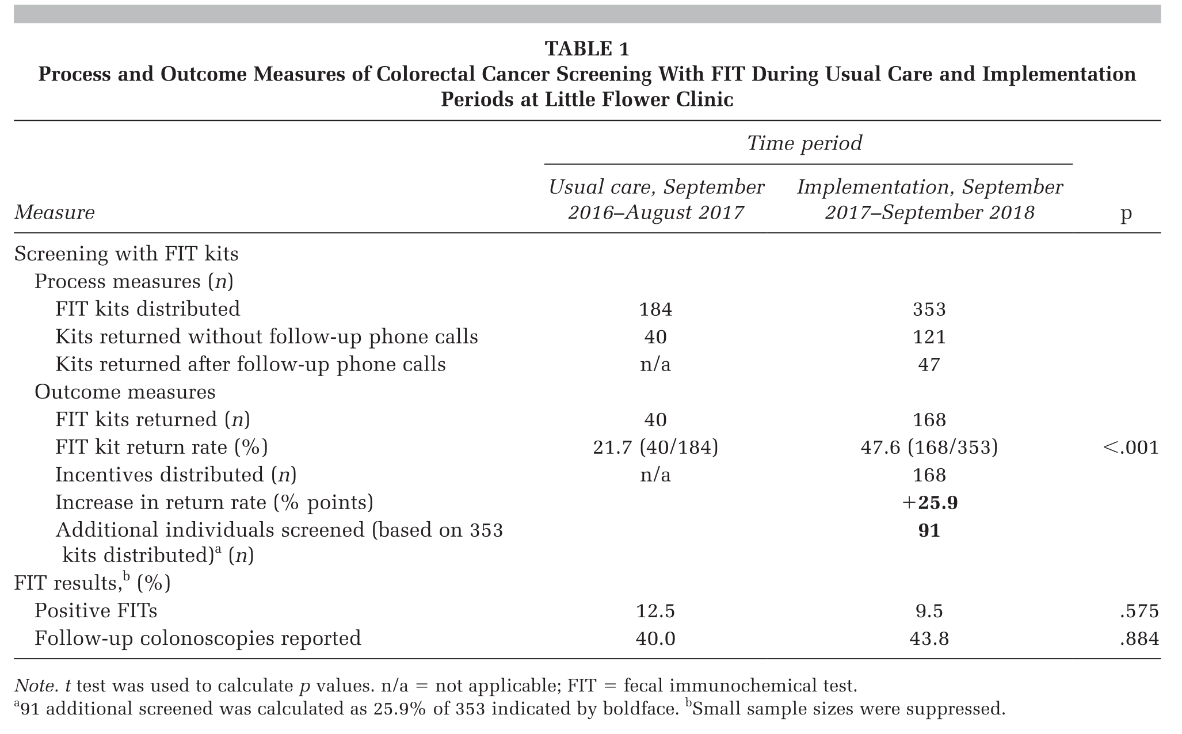
FIT completion without follow-up colonoscopy
Three most recent studies found ~20% increase in FIT completion rates
~ $60-140 total (includes all aspects of intervention) per completed FIT

Slide 2
Patient reminders (5/5 used):
Generally consisted of a care coordinator, patient navigator, or nurse making phone calls with letters to remind patients to return their FIT test.
If a site implemented patient reminders for CRC that was overdue, the FIT kit was included
Provider reminders (2/5):
Care coordinator generally identified patient through population management or manual data pull
Vague description but if electronic, reminders were manually placed by care coordinator or front-end staff before the scheduled appointment
Navigation (1/5):
Responsible for tracking the FIT kits and patient reminders
Assisted patients to address relatively simple barriers, such as arranging transportation to the clinic, providing further instructions on using the kit, or replacing kits that had been lost.
Provider assessment and feedback (2/5): implementation not explained

Slide 3
Thoughts / Opportunities:
Surprised that completion rates didn’t include follow-up coloscopies for positive FIT
important but may have added too much complexity
None of the studies implemented automated provider alerts
Our CHCs have expressed concern about false positive alerts, but one study stated the manual process may not be scalable or maintainable
Patient reminders are not being used proactively to bring patients in or mail FITs out
Navigation function was more for patient reminders to return FIT, since subsequent coloscopy wasn’t followed (ours sounds better and CDC provides guidance)
Population management seems key to most interventions
An involved care coordinator at each clinic could be very helpful (especially if manual interventions)
Provider assessment and feedback will likely be, at best, modifying a current system, rather than implementing something new
CDC seems very interested in cost
created a tool and is reported in all studies

Slide 5
﻿The purpose of this study is to determine the effectiveness and cost of implementing a provider reminder system entered manually and supplemented with patient reminders and provider assessment and feedback in one FQHC
﻿21.2 percentage point increase in CRC screens completed
﻿The total cost of implementing EBIs was $40908.97
283 additional screens at $144.65 each

Slide 6
﻿Three key features to support the implementation of EBIs were identified (CFIR assessment):
EMR system with data reporting capacity through a population management tool
care coordinators to help facilitate the implementation of reminders
provider champion to promote the program

Slide 7
﻿Provider reminders:
Care coordinator team used EMR population health management tool to generate weekly patient report
identified those patients who might be due for CRC screening (fecal immunochemical test [FIT], fecal occult blood test [FOBT], or colonoscopy),
EMR alerts (flags) were placed manually into their charts and would pop up when the provider was with the patient.
Copy of the flag was sent to the care coordination team’s desktop for follow-up to determine whether the patient had an order placed for FIT or colonoscopy
Care coordination team removed EMR flags once the screen had been completed.

Slide 8
Patient reminders:
﻿Care coordination team determined whether patients had an order placed for FIT/FOBT test or colonoscopy
﻿If an order had been placed for a FIT/FOBT test 90 days ago, but the test was not yet completed, the care coordinators initiated up to two follow-up calls to request return of FIT/FOBT tests
﻿If positive FITs/FOBTs were returned, the care coordination team phoned patients to encourage them to schedule a colonoscopy
﻿For patients who could not be reached by phone, care coordinators sent a mailed letter to the patient’s listed home address.
If a patient did not schedule a colonoscopy during the study period, the provider took an active role in initiating a conversation with the patient by sending a letter and/or addressing it during the next visit.

Slide 9
Provider assessment and feedback:
﻿Data manager and health system leadership analyzed all CRC screening data each quarter. During quarterly health system meetings, each provider received their CRC screening rate in reference to other providers.

Slide 10
﻿Overall screening completion rates (defined as the proportion of the FQHC’s age-eligible
population who received an order to be screened with FIT/FOBT or colonoscopy (not reported)
and completed the screening during the time period.

Slide 11
﻿Effectiveness of these EBIs on CRC order and screening uptake was significant across all populations served and independent of insurance status
﻿Incremental cost is higher for this health system than for some other FQHCs. This is in part because manual entry of provider and patient reminders into the EMR.
Expect automated reminders would decrease cost
Initiated multicomponent approach
Would have liked to implement and measure the effect of each EBI separately
Tracking process data that might isolate each EBI could help future implementation analyses
Unable to collect and report data on diagnostic colonoscopy follow-up for those with positive FITs

Slide 13
﻿The objective of this study was to analyze the effectiveness and cost of patient incentives, together with patient navigation and patient reminders, to increase fecal immunochemical test (FIT) kit return rates in one clinic
﻿Return rate increased by 25.9 percentage points (from 21.7% to 47.6%)
Additional 91 people screened at $134.61 per screen

Slide 15
Patient incentive:
﻿Patients were given the $10 gift card (food market) when they returned the completed FIT kit
Patient navigator and reminders:
﻿Navigators responsible for tracking the FIT kits and reminders
Biweekly phone or mail reminder to complete and return
Assisted patients to address relatively simple barriers, such as arranging transportation to the clinic, providing further instructions on using the kit, or replacing kits that had been lost.
Patient navigators continued to follow up until the kit was completed and returned or the patient indicated unwillingness to complete the test
After 1 year, the navigator received no response and the kit was not returned, the patient was removed from active follow-up.

Slide 17
﻿There were challenges in improving FIT kit return rates, such as kits not being returned to LFC in a timely manner or patients forgetting that they had received FIT kits.
﻿follow-up rate for colonoscopies after positive FIT tests did not increase substantially between the usual care and implementation periods
probably due to other barriers (transportation and bowel prep)
these barriers should have been systematically addressed for colonoscopies

Slide 19
﻿The purpose of this study is to evaluate the effectiveness of implementing patient reminders to increase fecal immunochemical test (FIT) kit return rates in nine federally qualified health centers (FQHCs).
19.6 percentage point increase in FIT return rates
$60.18 cost per FIT kit returned

Slide 20
﻿Overall, implemented provider assessment and feedback and at least two other EBIs: patient reminders, provider reminders, and interventions that reduce structural barriers to increase referral and completion of CRC. (only patient reminders and FIT return presented)
Most in need FQHCs selected for project﻿
WVPICCS ﻿provided technical assistance, professional development training, and practice facilitation for quality improvement
﻿FQHC partner clinic sites assessed their CRC screening practices and systematically ﻿reviewed their current use of electronic health records to identify improvements

Slide 21
Patient reminders:
Initiated within 7 to 21 days of unreturned FIT
Used stages of change health theory
﻿calls consisted of a series of simple questions and an algorithm to help assess the patient’s stage of change in completing the FIT
﻿After determining the patient’s stage of change, they delivered a tailored stage- specific message to motivate the patient to complete the screening
If not returned in 3 weeks another call was placed
calls and letters (whether or not used) and the sequence of these varied by FQHC

Slide 23
﻿
﻿patient and provider reminder systems, provider assessment and feedback

Slide 24
provider assessment and feedback processes beginning in July 2013 by facilitating clinic‐specific review of CRC rates with quality improvement and data management staff.
provider reminder system for CRC screening was established by standardizing CRC screening policies and implementing a centralized data reporting and analytics solution to prompt the clinic when clients were due for screening services. The provider reminder system was implemented through previsit planning, in which front desk staff would determine whether patients with appointments scheduled for the following day were due for CRC screening and flag those due for the medical provider.
patient reminders were mailed to those due for screening, and fecal immunochemical test (FIT) kits were included in these mailings to eligible patients. FIT kits were distributed at all clinics during nonacute visits to eligible patients as well.
Standardized protocols were established across all clinics in the health system to follow up with patients who did not return FIT kits.

Slide 25
﻿Direct-mail FIT program at 9 medical clinics, along with a follow-up reminder
letter and automated telephone calls to those not up-to-date with
recommended screening. Supplemental

Slide 26
Average‐risk patients who were not up to date with CRC screening were identified through a combination of automated electronic medical record extraction and manual review.
First mailed an introductory letter, including answers to frequently asked questions, to all patients who needed a CRC screening appointment.
The letter provided a web link to an online portal to opt out of receiving the FIT kit by mail or to request an FIT kit (in case they misplaced their original kit).
Approximately 2 weeks after the initial mailing, patients who had not opted out and had a valid address were mailed a FIT kit with the easy‐to‐read instructions, which included pictures and text in each patient’s language.

Slide 27
Patient Navigation Model for Increasing Colonoscopy Quality and Completion
Measuring Breast, Cervical, and Colorectal Cancer Screening Rates in Health System Clinics
https://www.cdc.gov/screenoutcancer/

