Slide 1
AUCH Community Health Services Division

Slide 2
Refresh: What is AUCH?

Slide 3
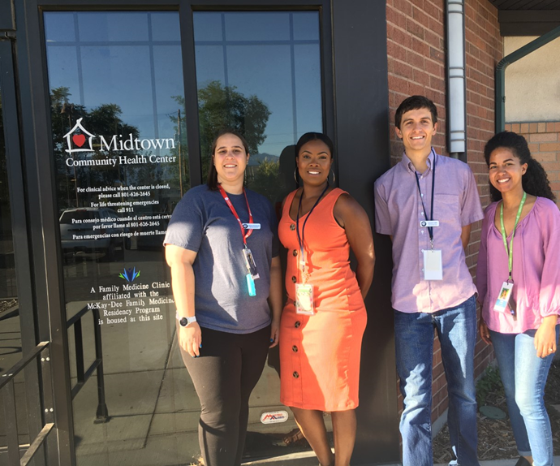
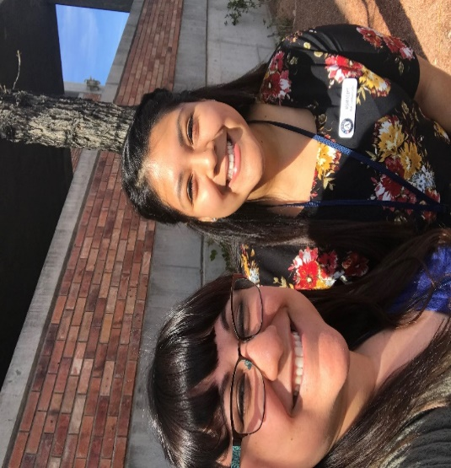
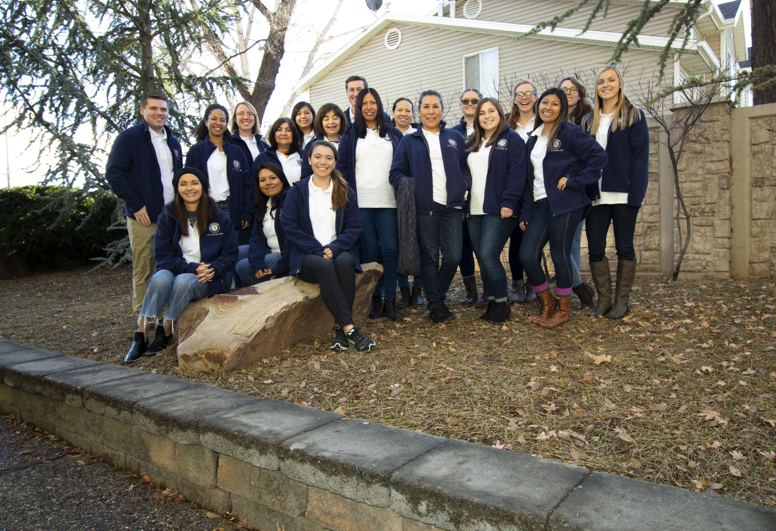
Reducing Barriers to Care: Community Health Services (CHS) Division at AUCH
The CHS division at AUCH implements or supports direct service programs in the community:
Utah Healthcare Corps
AmeriCorps
Weber
Washington
SLCO
Utah
SelectHealth
SLCO
Alliance
Weber
Washington
COVID-19
UDOH – Weber, Washington, Utah
SLCO – SLCO

Slide 4
The Utah Healthcare Corps Program
A direct service program focused on providing access to healthcare and social resources for underserved populations across the state through the Utah Healthcare Corps (UHC) Program
UHC is the name of the program you all are supporting within the CHS division
AUCH
CHS
UHC

Slide 5
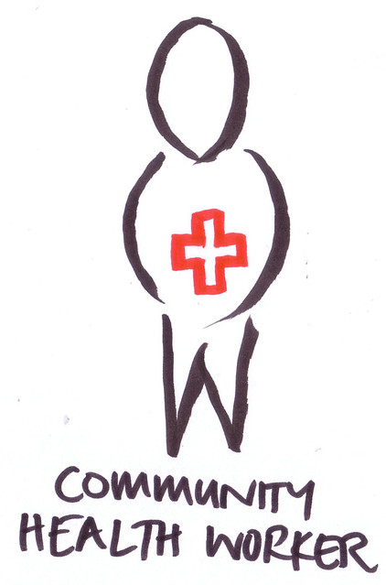
The Utah Healthcare Corps Program
The UHC provides the following services:
Community Health Worker (CHW) intervention
Full-time AUCH CHWs and AUCH CHW AmeriCorps Members
Care coordination, case management, and special project services in partnership with several direct service organizations
Other AmeriCorps members
“Patients” versus “Clients”

Slide 6
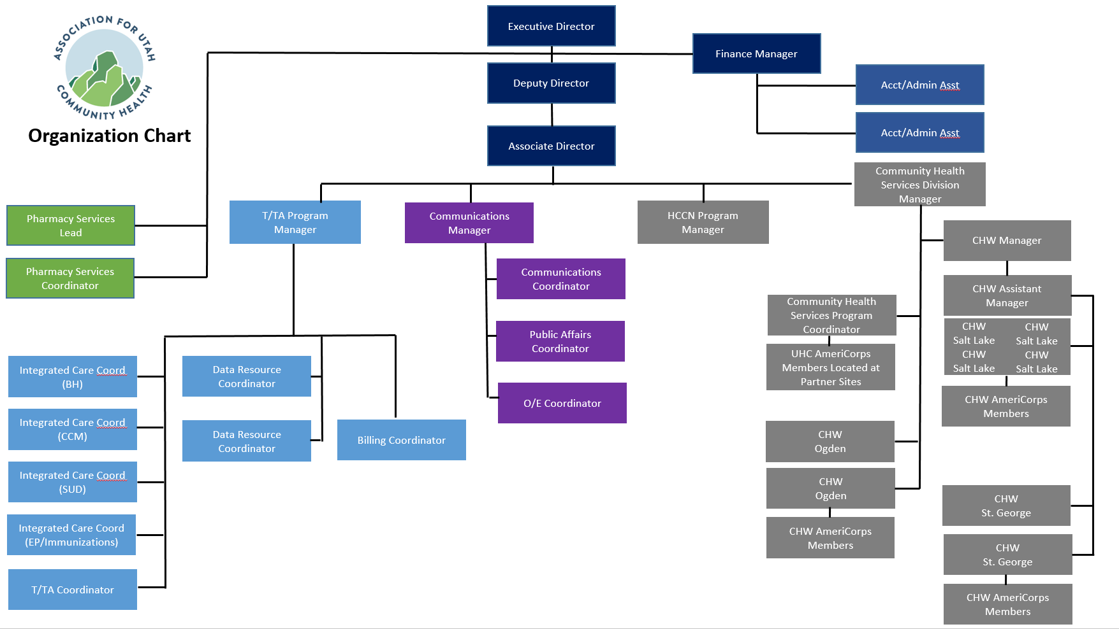
COVID-19 Response Teams
UDOH & SLCO

Slide 7
Working with the T/TA Team
AUCH 2020-2021 Work Plan: Increase the percentage of health centers that collect data on social determinants of health.
How CHS can help:
Best practices for screening health center patients for SDOH
Utilizing CHWs to address these and other needs

