Slide 1
ServicePoint
CCP/SLCO CHW Teams

Slide 2
Home Page

Slide 3
Searching for a client/adding a client
When you click on client point, it will take you to the next screen where you can search for a client by name or ServicePoint ID.
You must search for their name before adding them to the system.
If there is already an existing name that matches the DOB but does not have the “home” icon next to their name, you can add them to the system.
If there is already an existing case with the home icon, you will make a new one and under alias you will enter CCP or SLCO

Slide 4
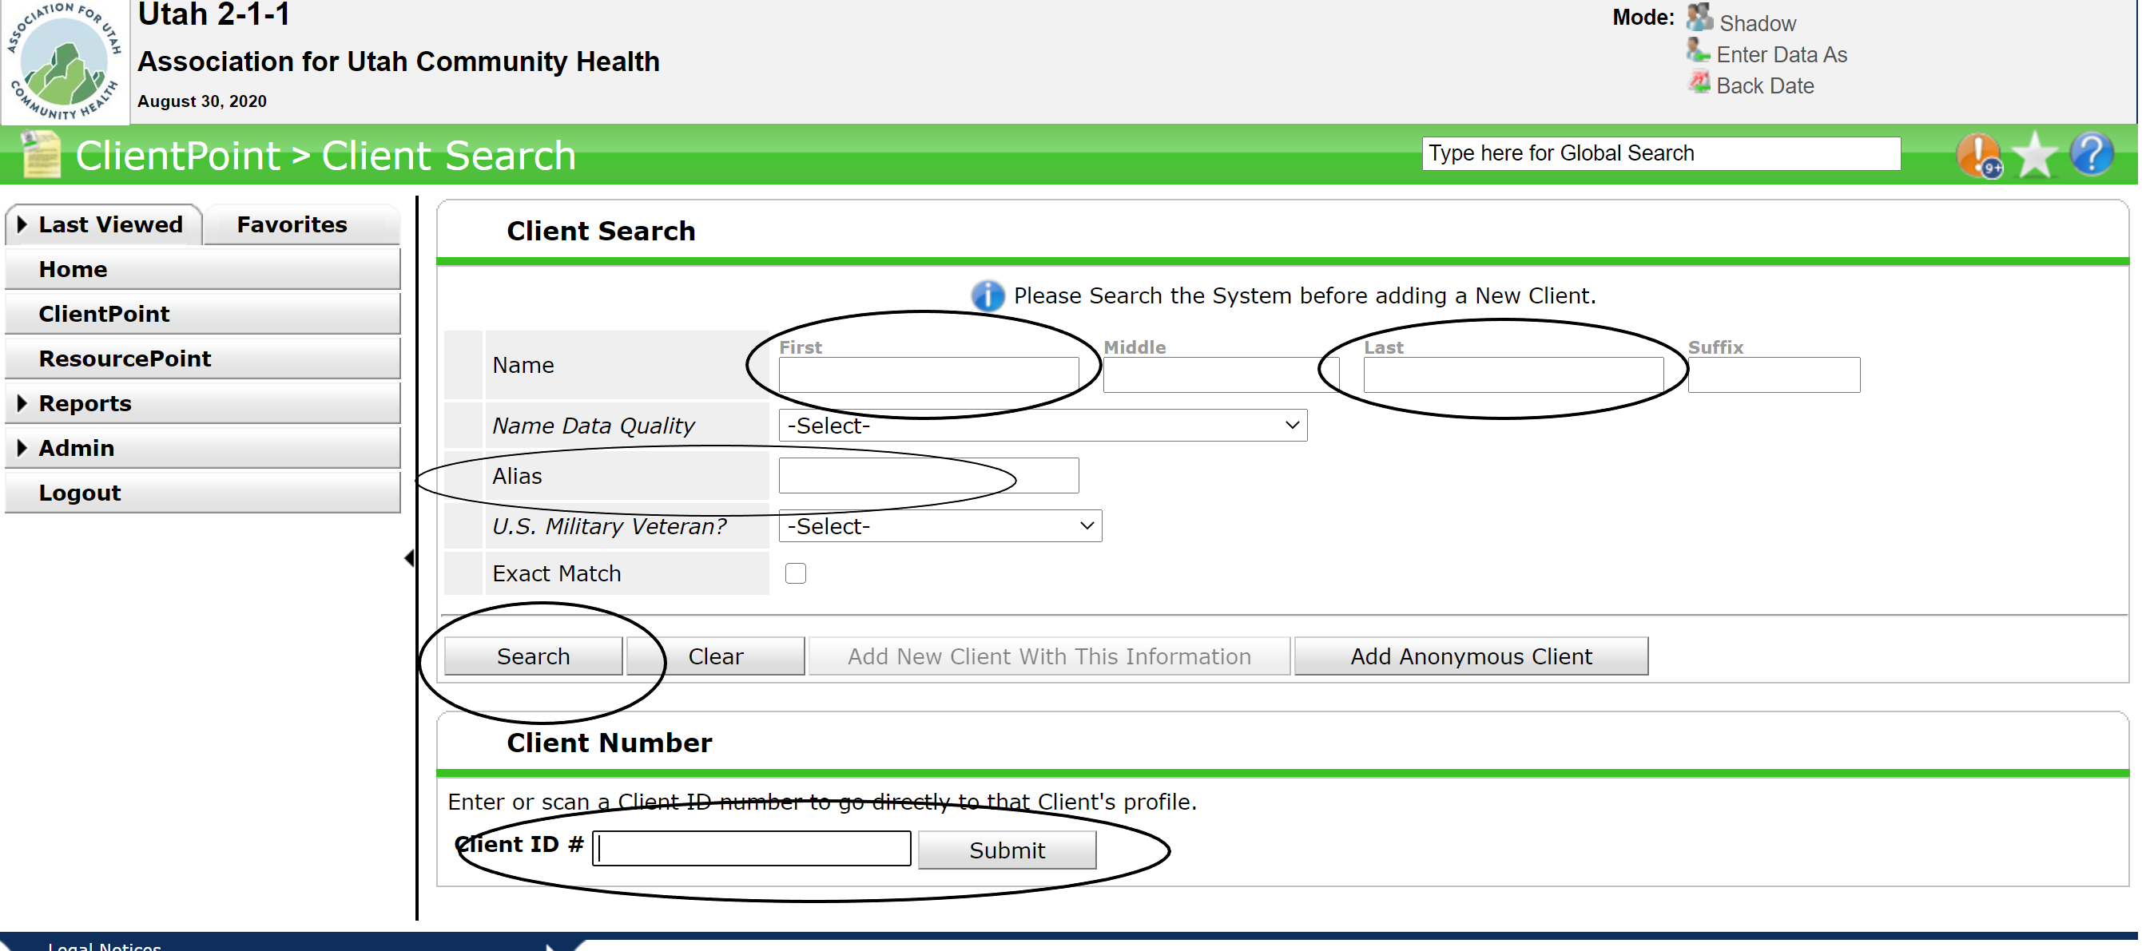

Slide 5
Starting a case
After you search or add a new client, you will have to fill in the following fields
Entry date: the day you create the case
Adding yourself as a case manager (pick from the select user list). This should also be the same date as the entry date.
Phone number
Zip code. If you have full address enter that as well.
Date of birth
Funding/Program Source (CCP or SLCO)
Reason for referral (Covid-19 positive or Covid-19 positive high risk)
Referring clinic/Organization
Tier of care (1-2 months)

Slide 6
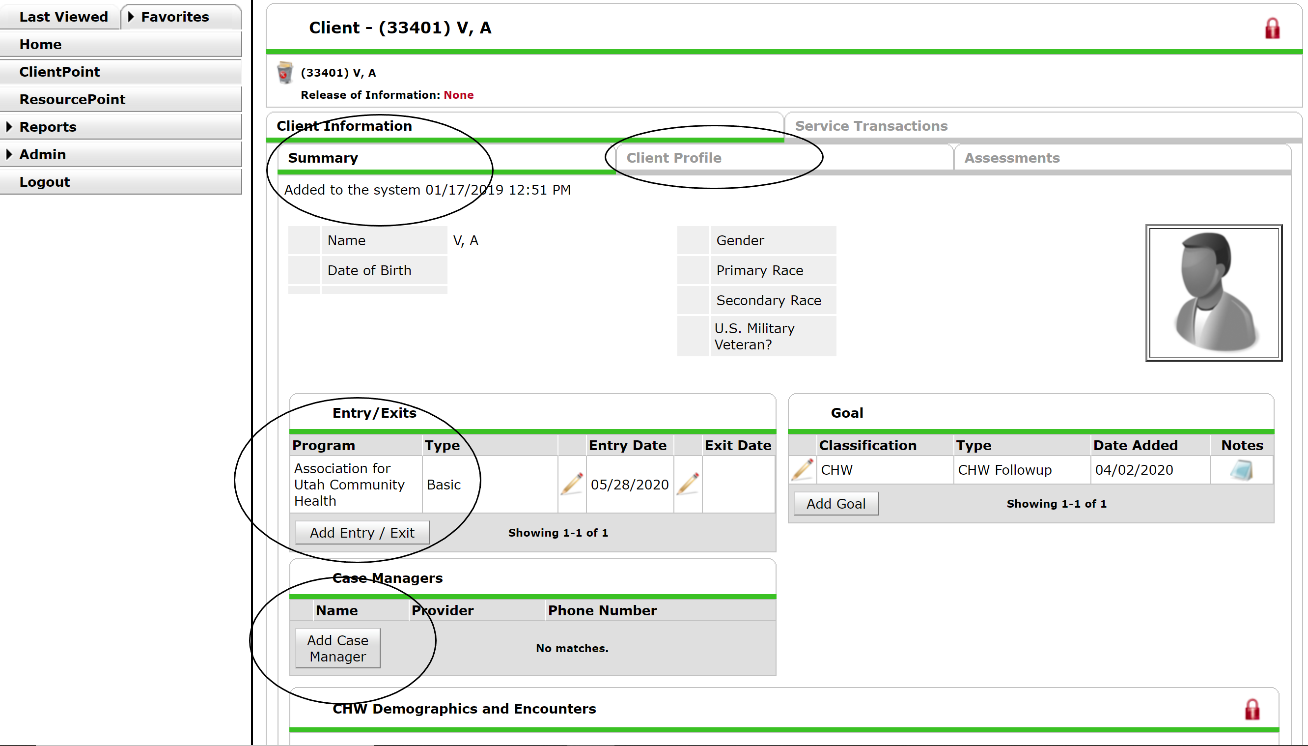

Slide 8
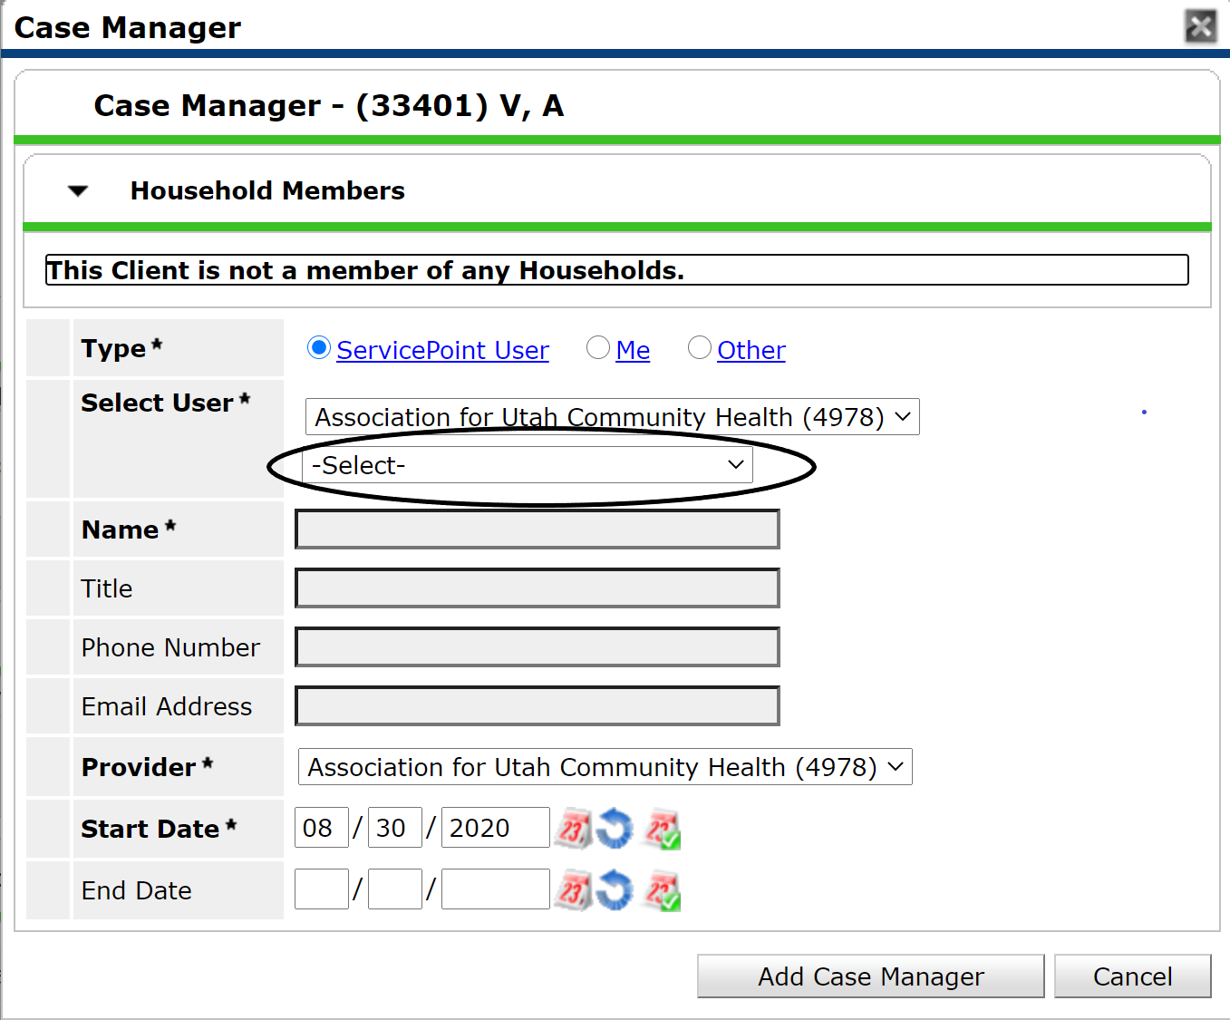
Click on the “select” box and search for your name. It will auto populate the rest. Your name is the only thing you must search for.

Slide 9
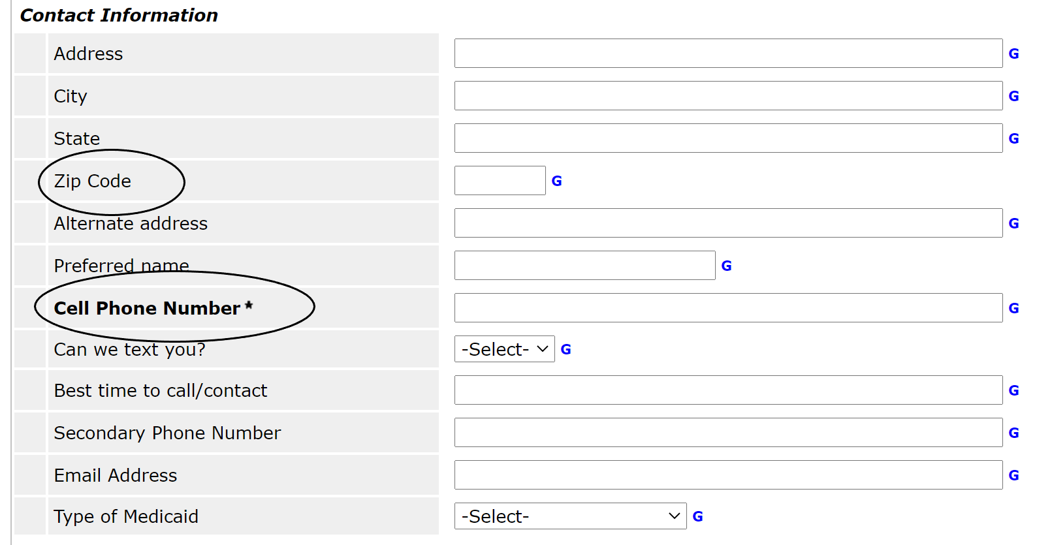
Scroll down after you have
added and entry date.
Add their zip code and phone
number.

Slide 10
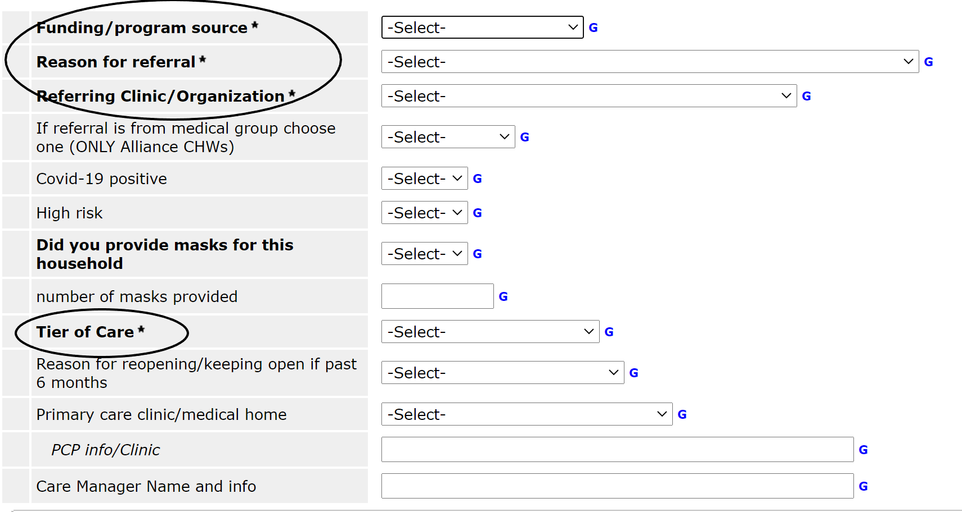
Anything bolded and with an asterisk must be entered in order to complete setting up a profile.
Tier of care will be set at 1-2 months

Slide 11
Required Fields
For funding/Program Source you will choose CCP or SLCO according to what program you are in.
For reason for referral you will choose Covid-19 positive or Covid-19 positive high risk.
For Referring clinic/organization you will choose according to referring partner

Slide 12
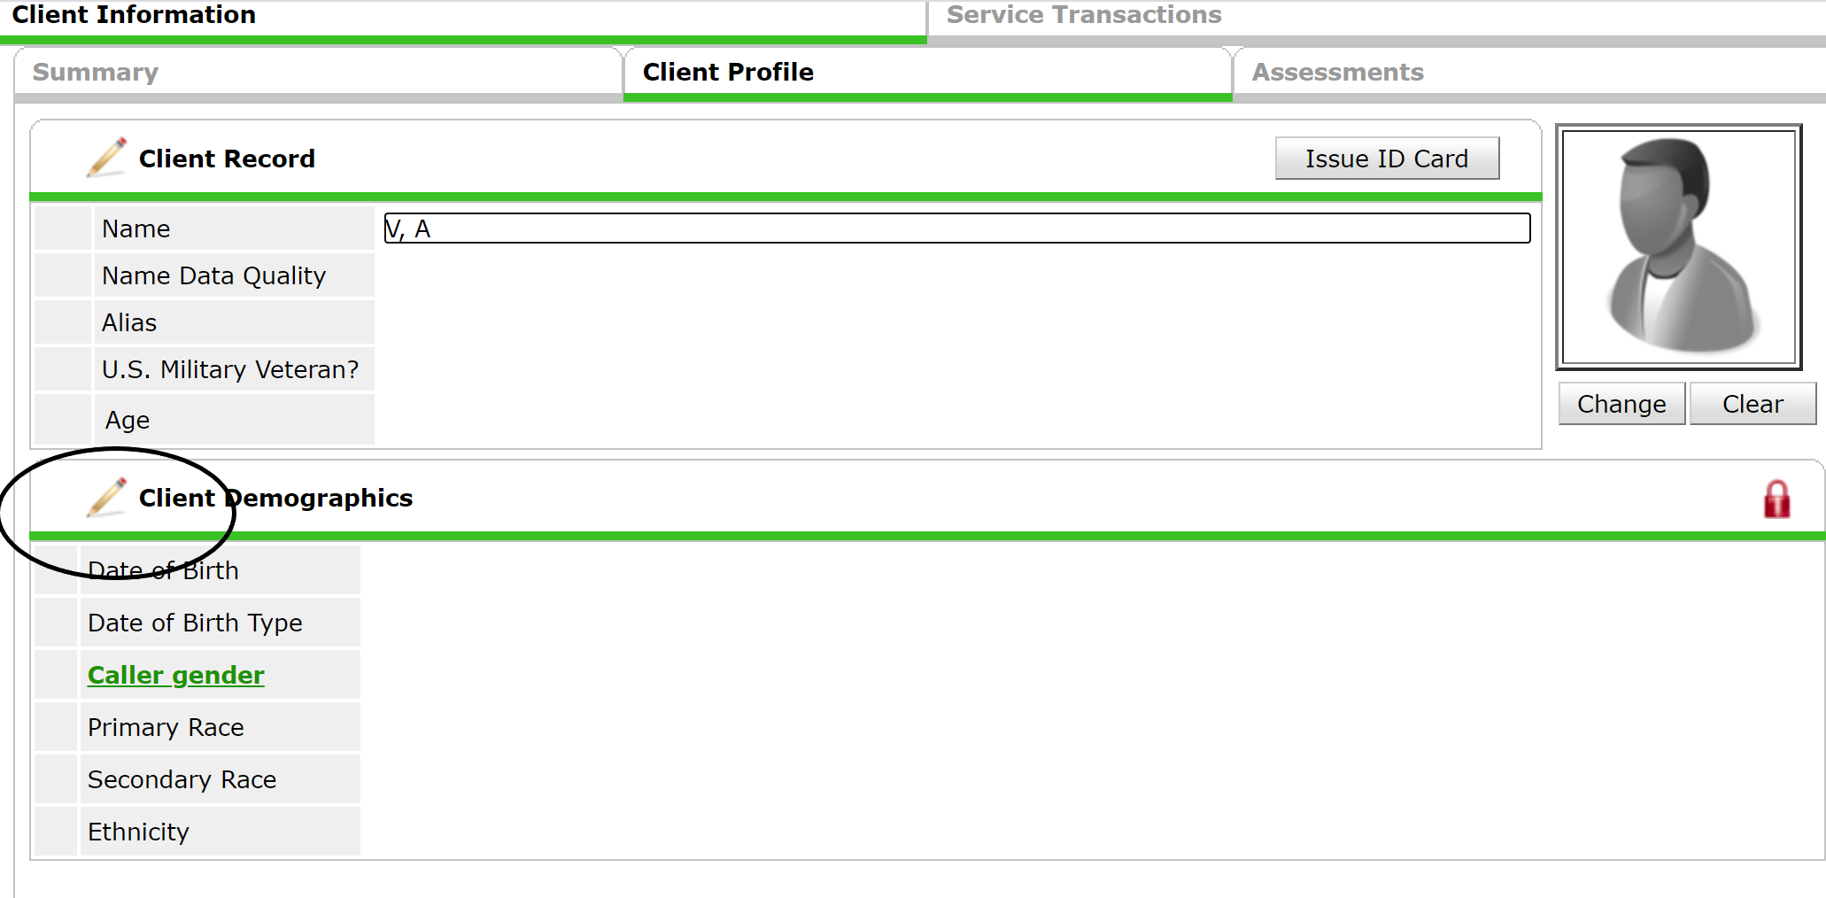
Clicking client profile will take you to where you can enter the client’s date of birth.
Click on the pencil and you can enter their date of birth, gender and race.

Slide 13
Encounters
- Remember to use the DAP format (Data, Assessment, Plan)
- The “data” field is required when adding an encounter.
- Anything bolded with an asterisk is a required field.
- You do not need to add time to the UniteUs field
- You do not need to check Y/N to the Care Radius field
- Choose the code that best suits the encounter
- If another CHW helps you choose their name under “contributing CHW”. Everyone’s names are listed.
- Add the time of your encounter (ex; 1:30 pm)
- Entry and exit date should be the same. Encounters cannot carry on over to the next day.

Slide 14
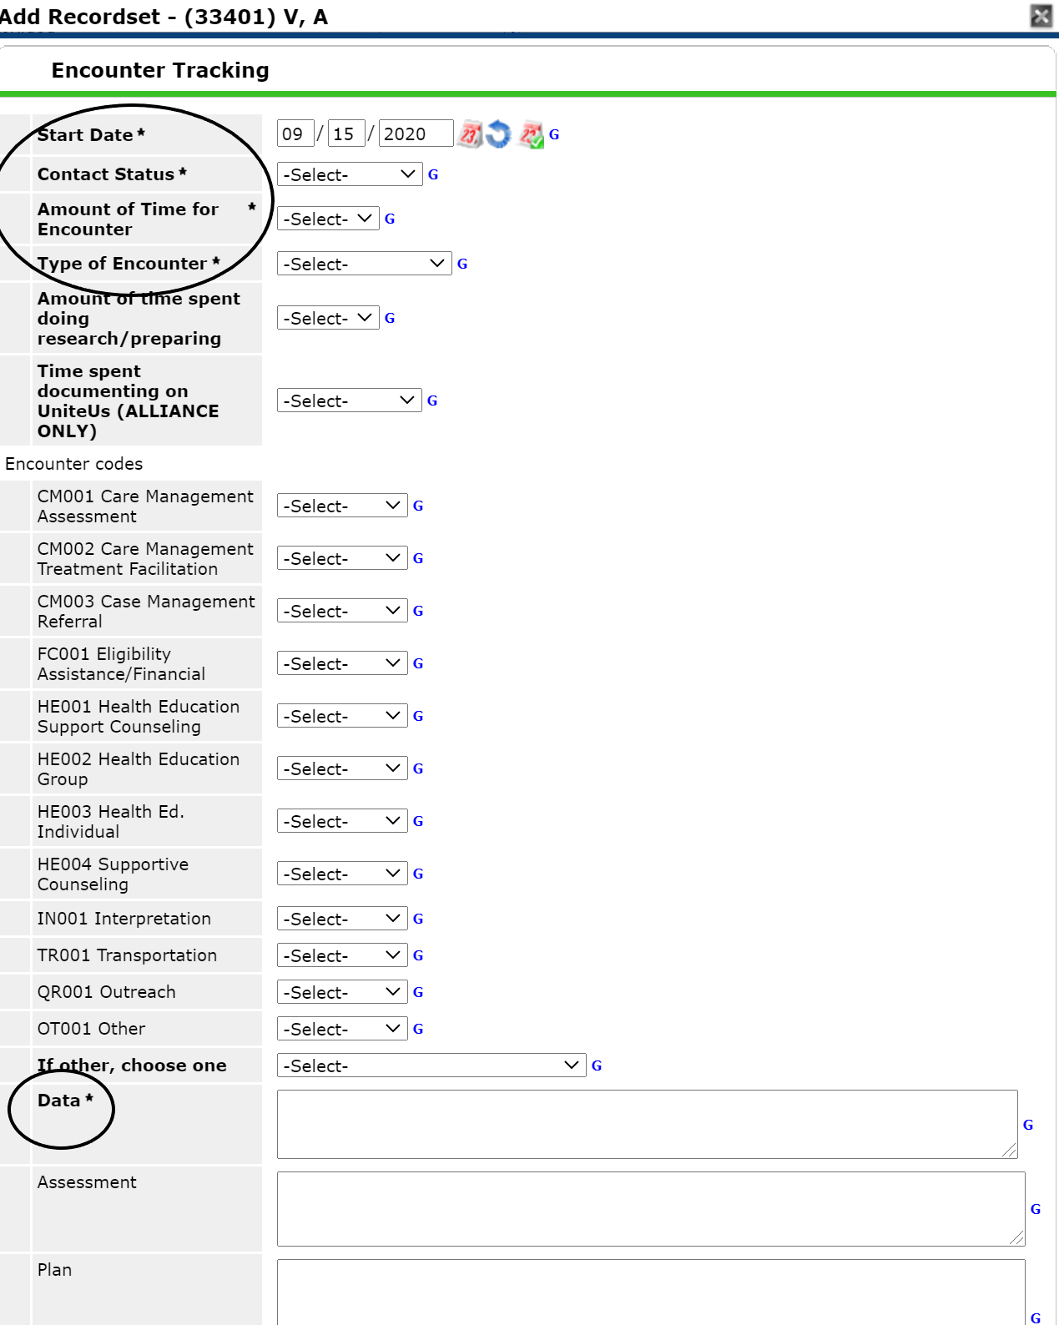
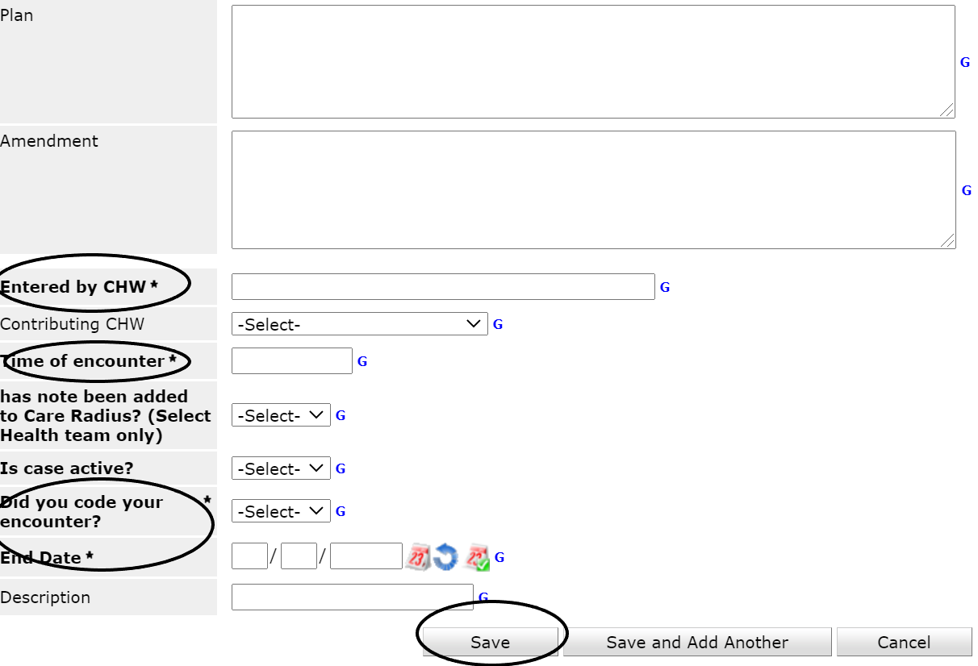

Slide 15
How to separate encounters
If you are reaching out or are being reached out to by your clients more than once a day, you should separate these encounters.
If it has been longer than an hour from the last phone call or text, document that as a separate encounter.

Slide 16
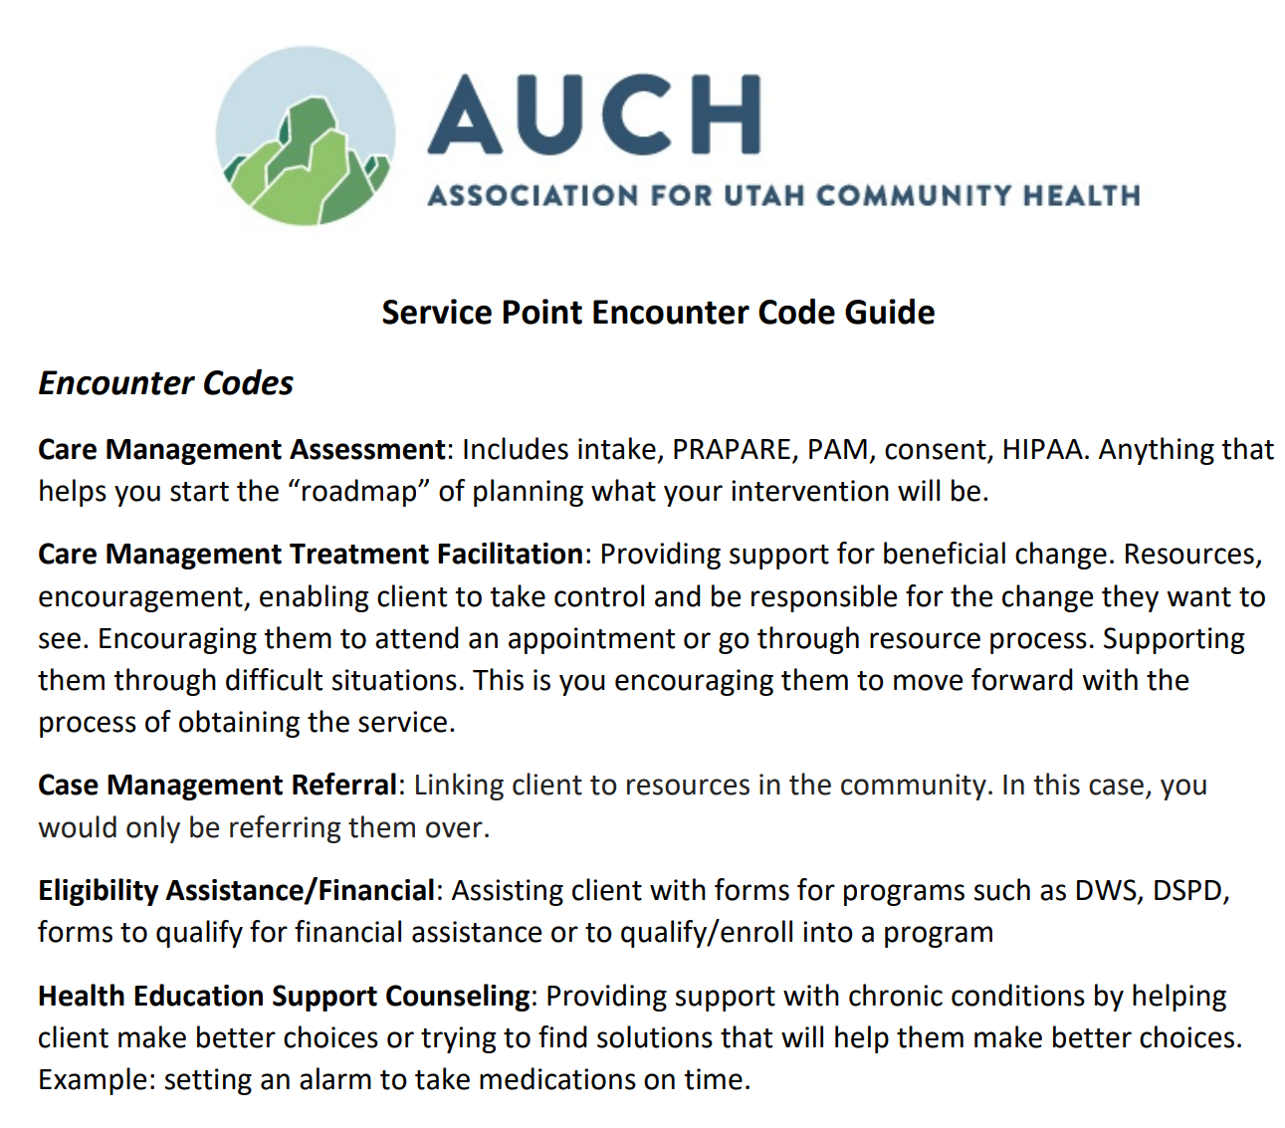
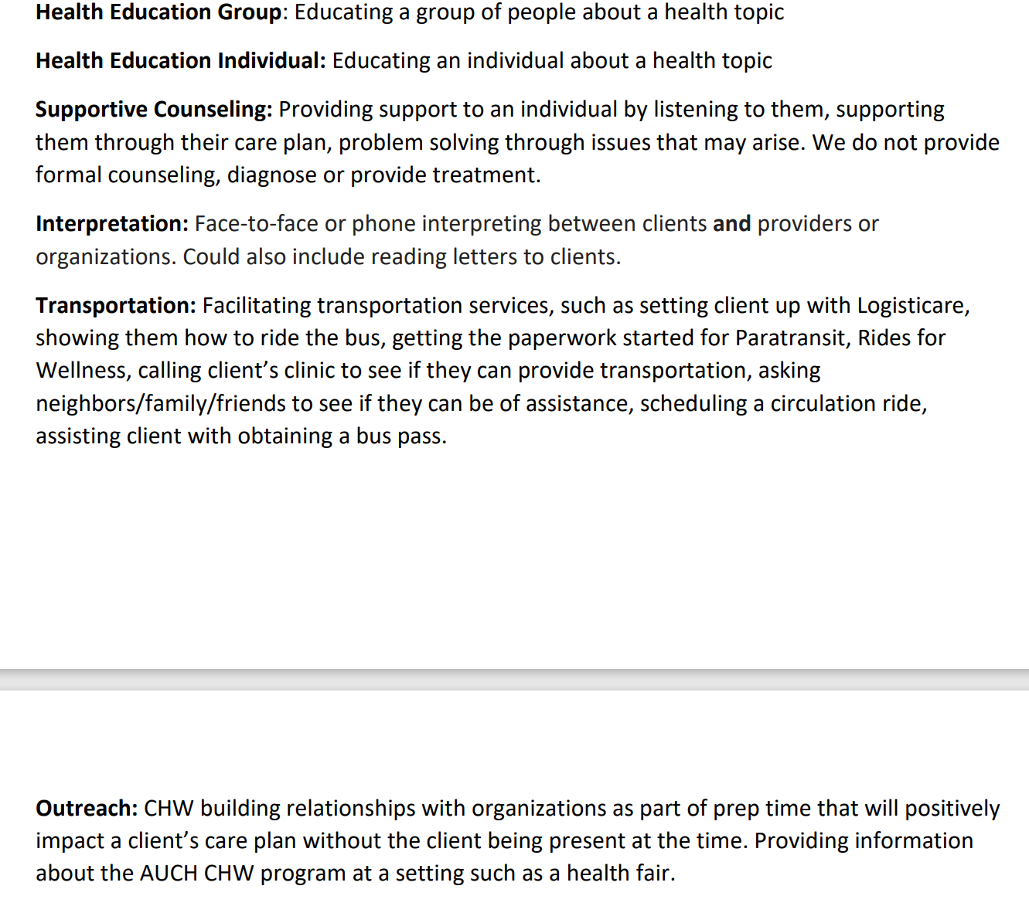

Slide 17
Example on how to code encounter
If your encounter is a 15-minute phone call, the coding time should also be 15 minutes.
If you encounter is a 15-minute phone call with 30 minutes research/prep time, the codes should reflect 45 minutes. These can be divided up between different codes as long as they add up to 45.
Prep time can be coded as outreach or other. If you choose other (OT001), choose an option from the drop down below that (if other choose one)

Slide 18
Referrals
- Select the type of referral (rental, food, utilities, etc)
- If you choose other, describe the type of referral made on the “other” box.
- Add the name of the agency/person you referred client to.
- Status will be left pending until you know the outcome or the referral OR successful if you are JUST providing the resource.
- You will choose “client” for who the referral is for.
Type of consent will be “client initiated” IF you are giving the client the information and client will reach out to agency themselves. If client initiated, referral can be closed the same day and marked as successful.
IF referral is left pending, you will close referral out when you know the outcome of referral and update the pending status.

Slide 19
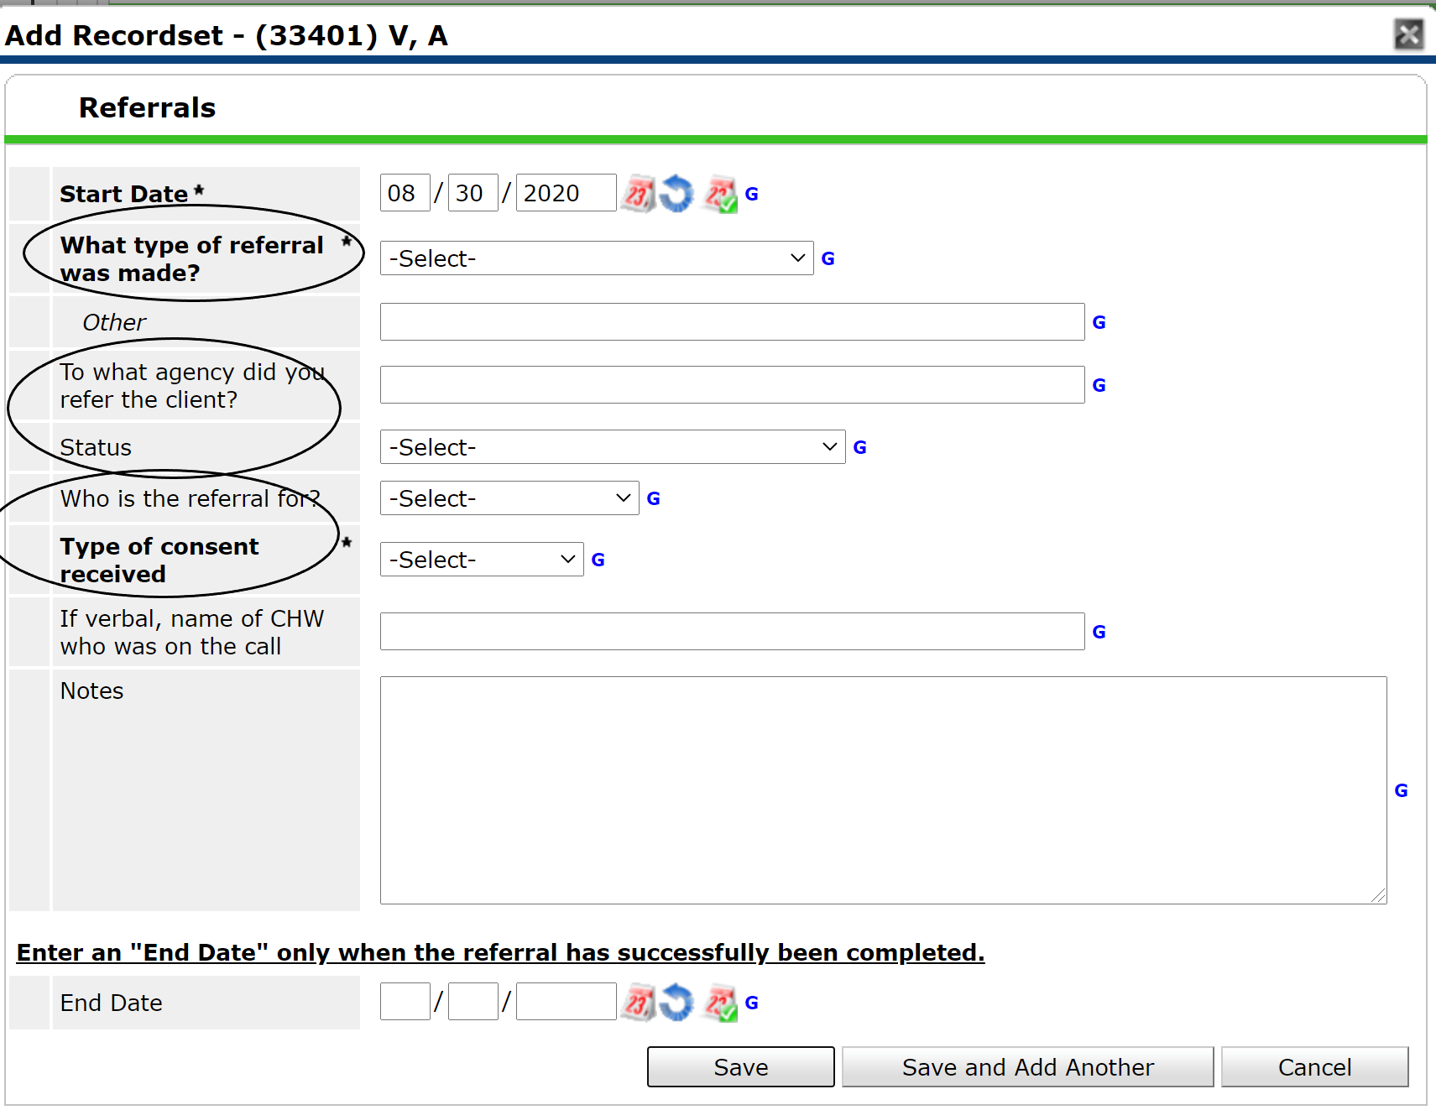

Slide 20
Goals

Slide 21
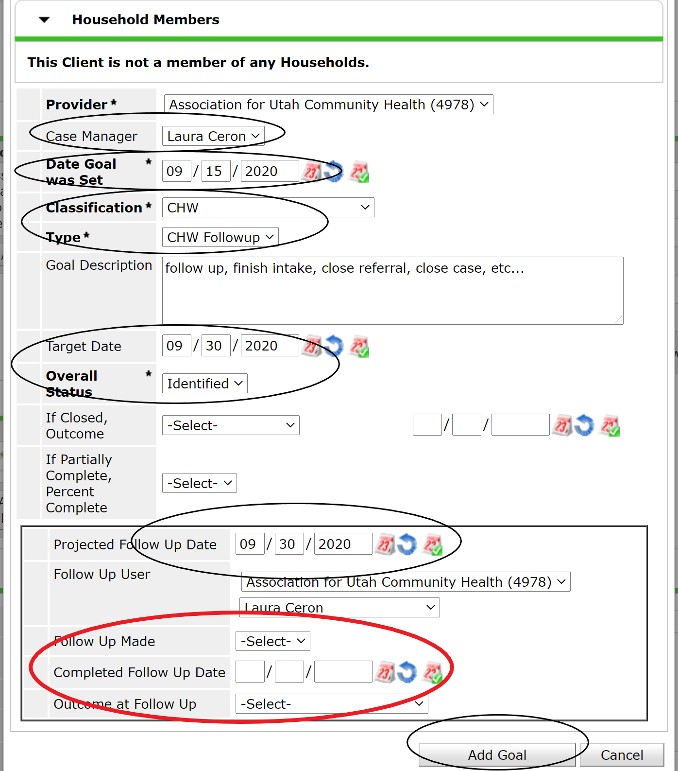
All the circled fields must be completed to successfully add a goal.
The fields circled red will be fields that need to be completed when the goal has been achieved.
Make sure to add yourself as a case manager in all your goals.
The date goal was set should be the same as the target date and projected follow up date.
You can add any notes on your goal description.

Slide 22
Closing a case
- Before closing a case, make sure you have closed out any assessments, referrals, encounters and goals you have made.
- You will also be putting an end date to the case manager (you) which will be the same date as the exit date.
- For “reason for leaving”, ONLY choose options that begin with SLCO/CCP
Destination will always be “CHW case closed”

Slide 23
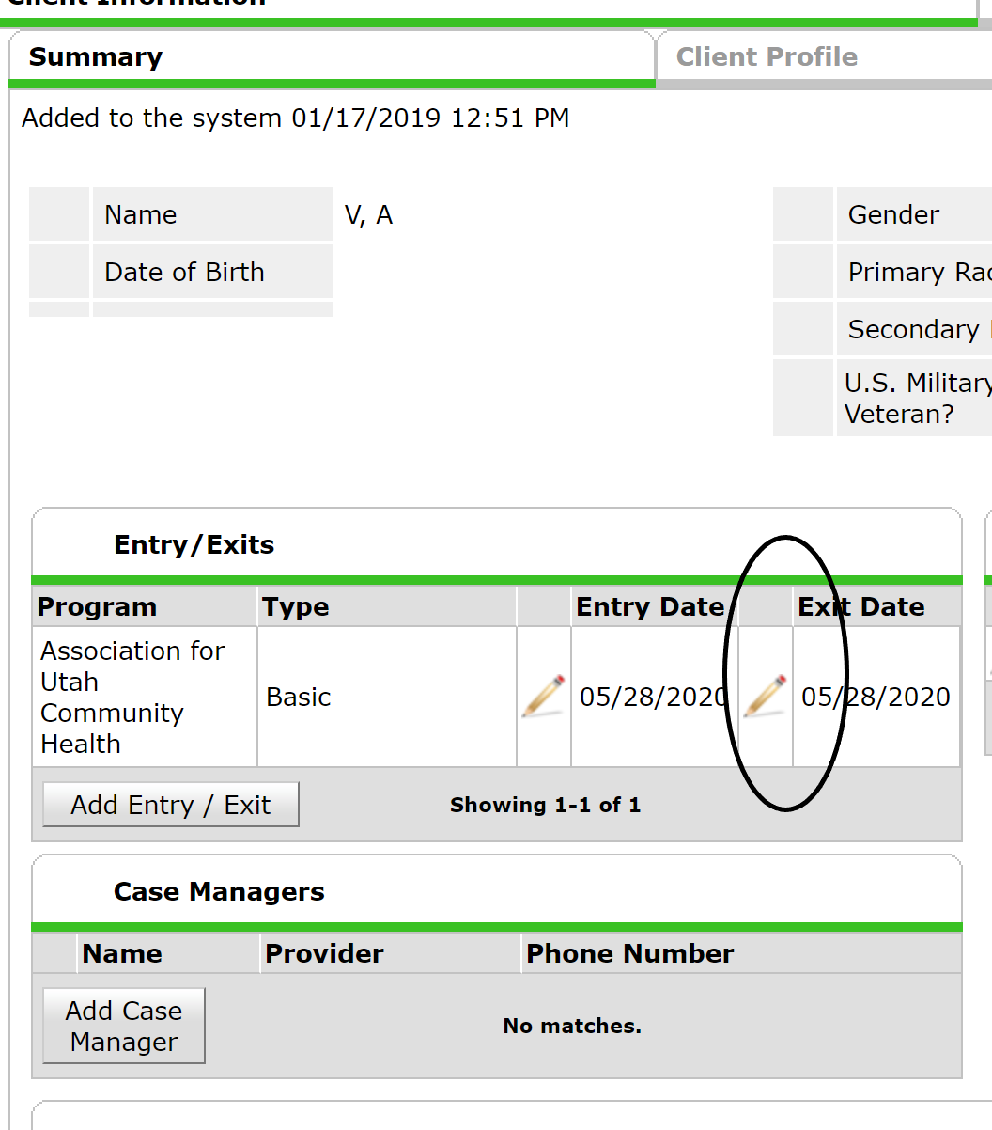
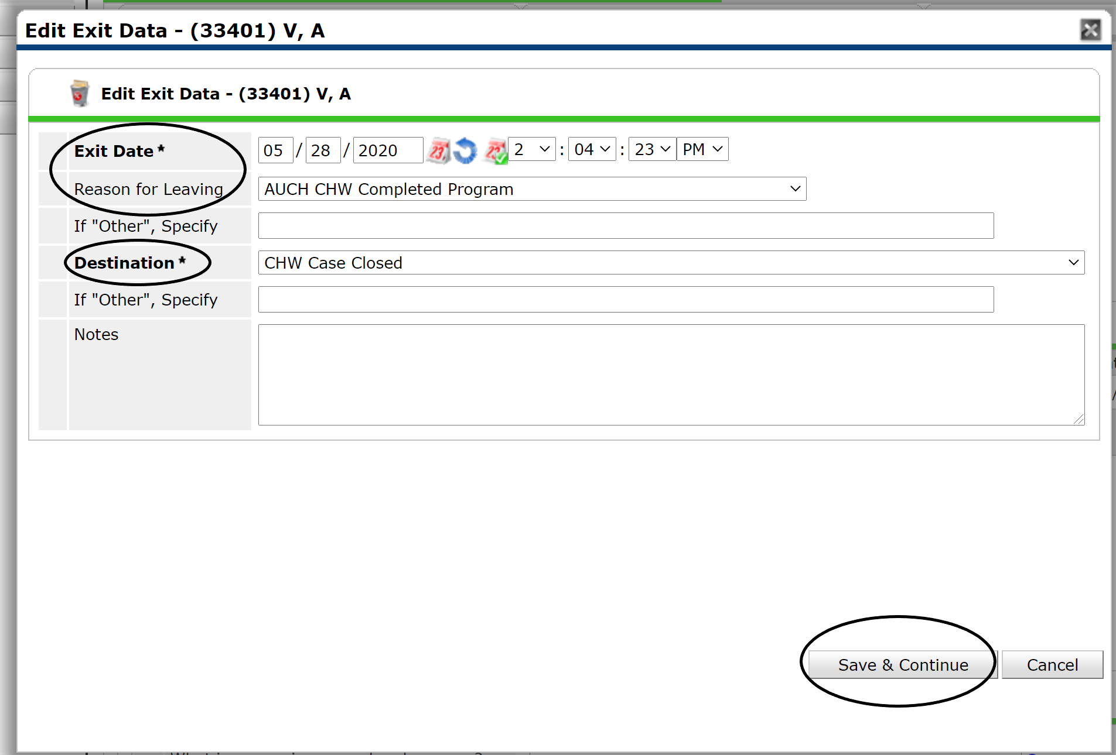

Slide 24
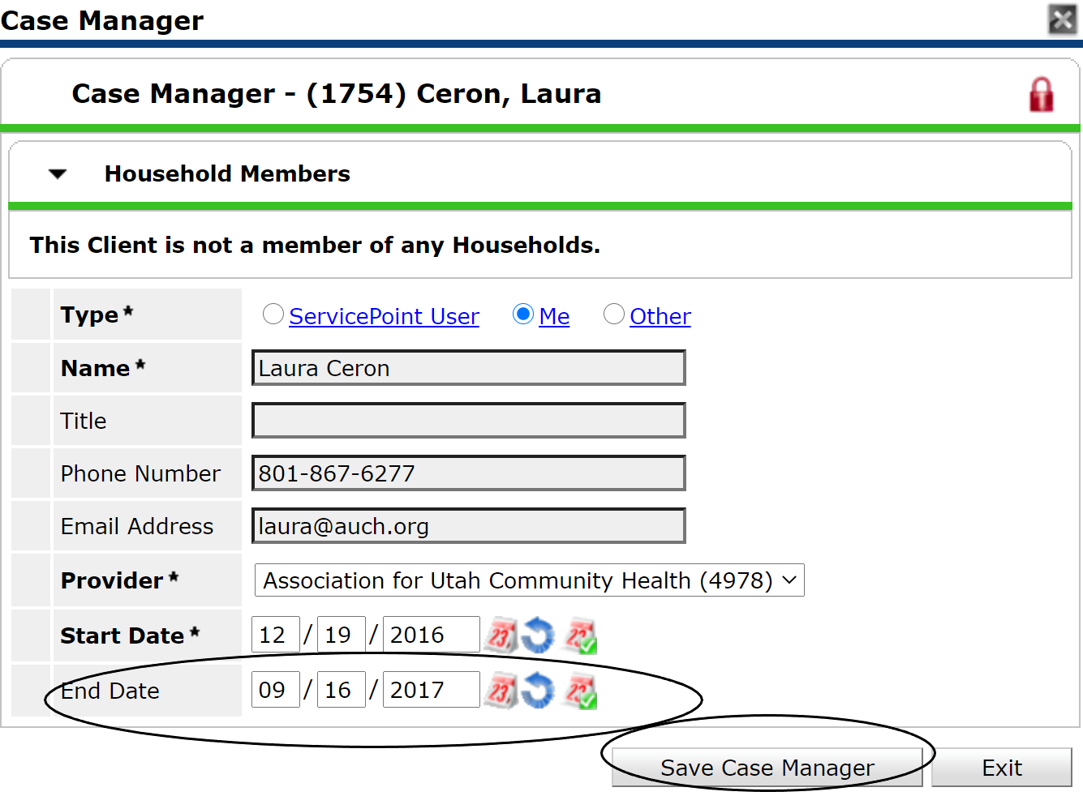
Closing case manager

