Slide 1
UServeUtah, National Service, & AmeriCorps

Slide 2
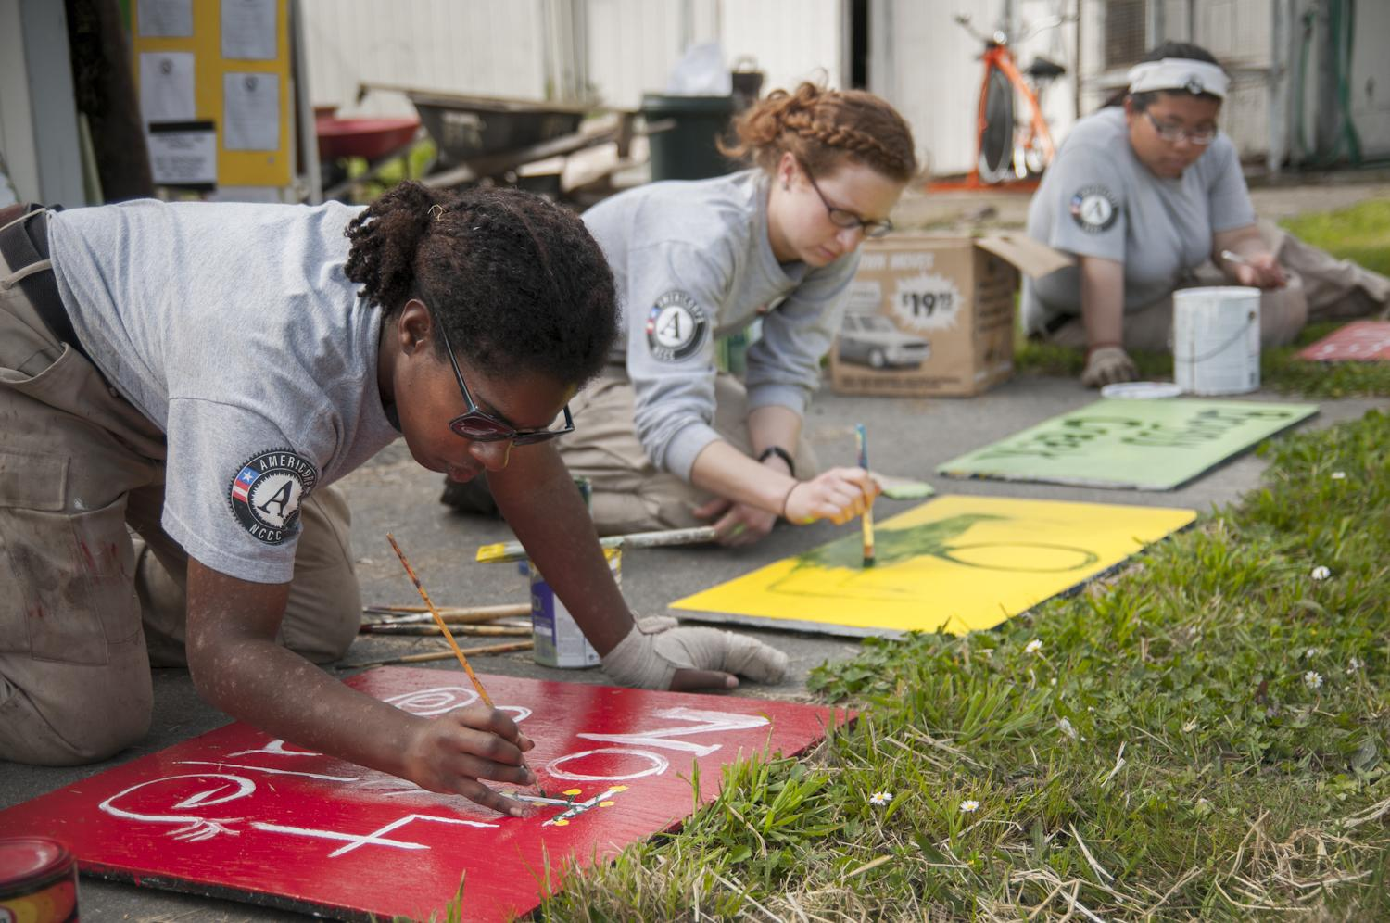
THIS PRESENTATION
UServeUtah
Who We Are
Role in National Service
National Service
Definition
Brief History
Structure
AmeriCorps 101
Goals
Benefits
Impact
Your Role & Impact
OBJECTIVE: Gain a better understanding of National Service, AmeriCorps, and how you are an important part of it all!

Slide 3
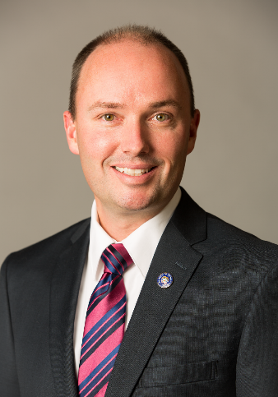
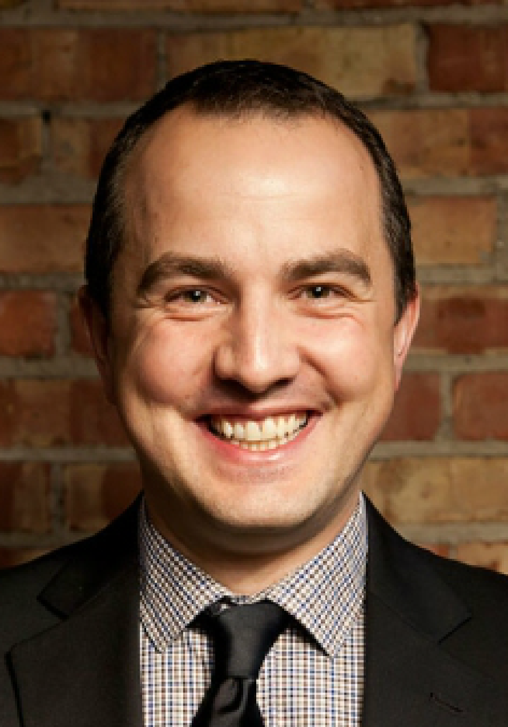
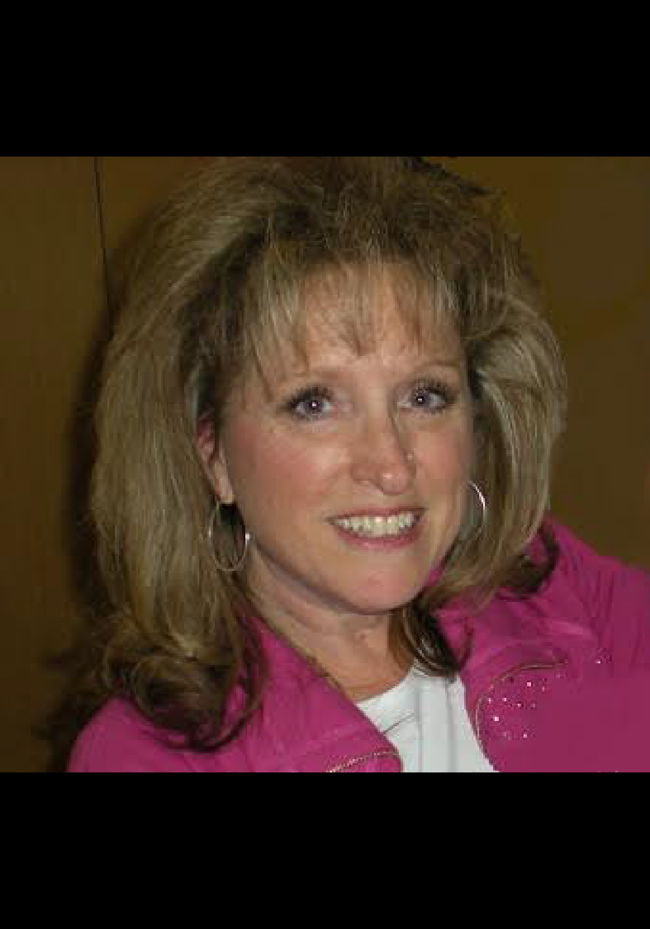
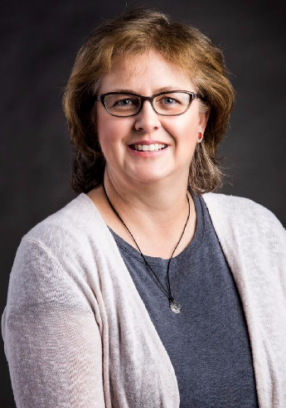
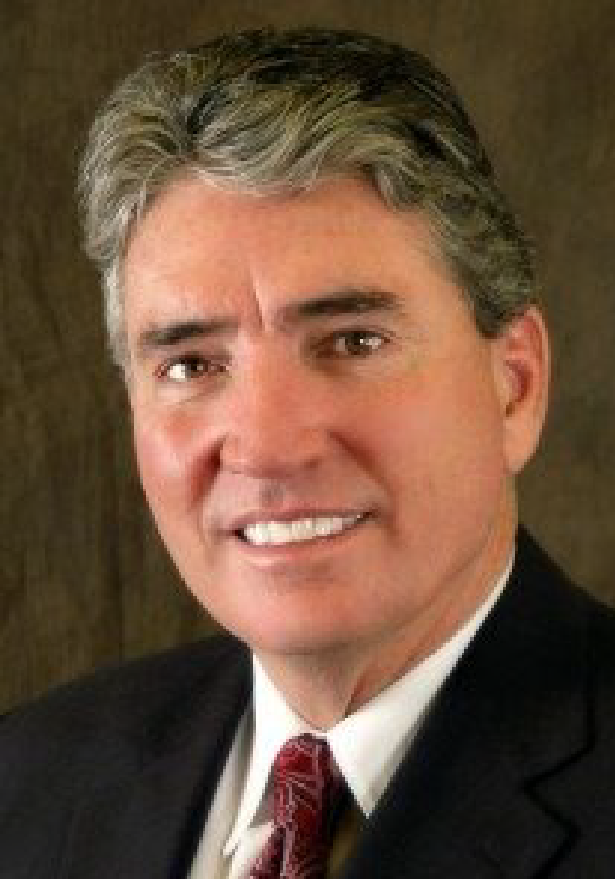
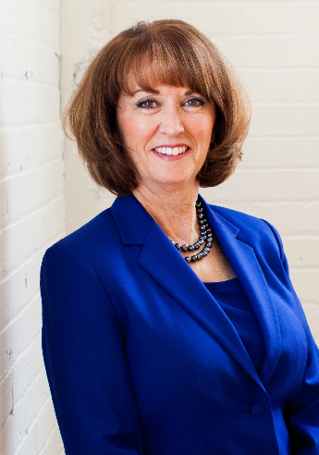
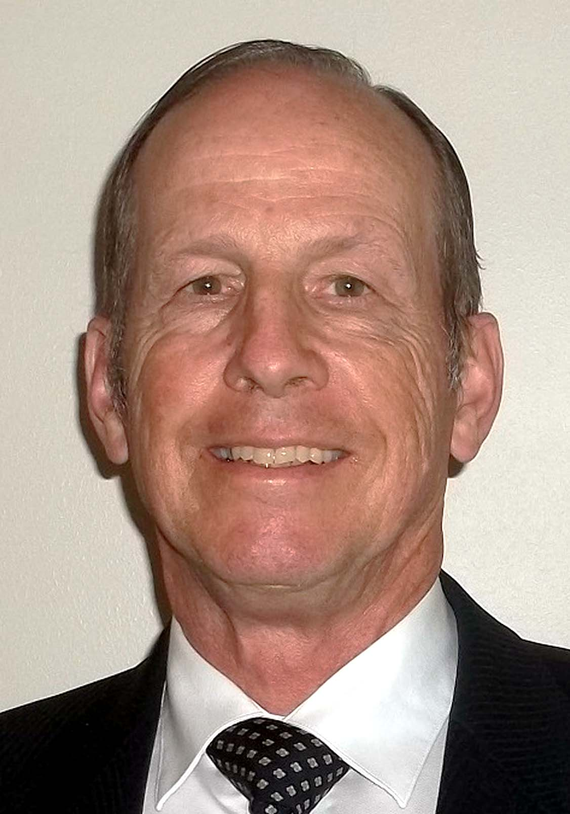
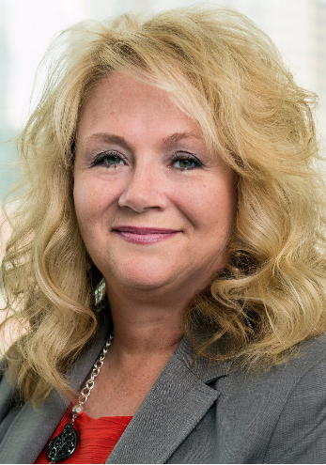
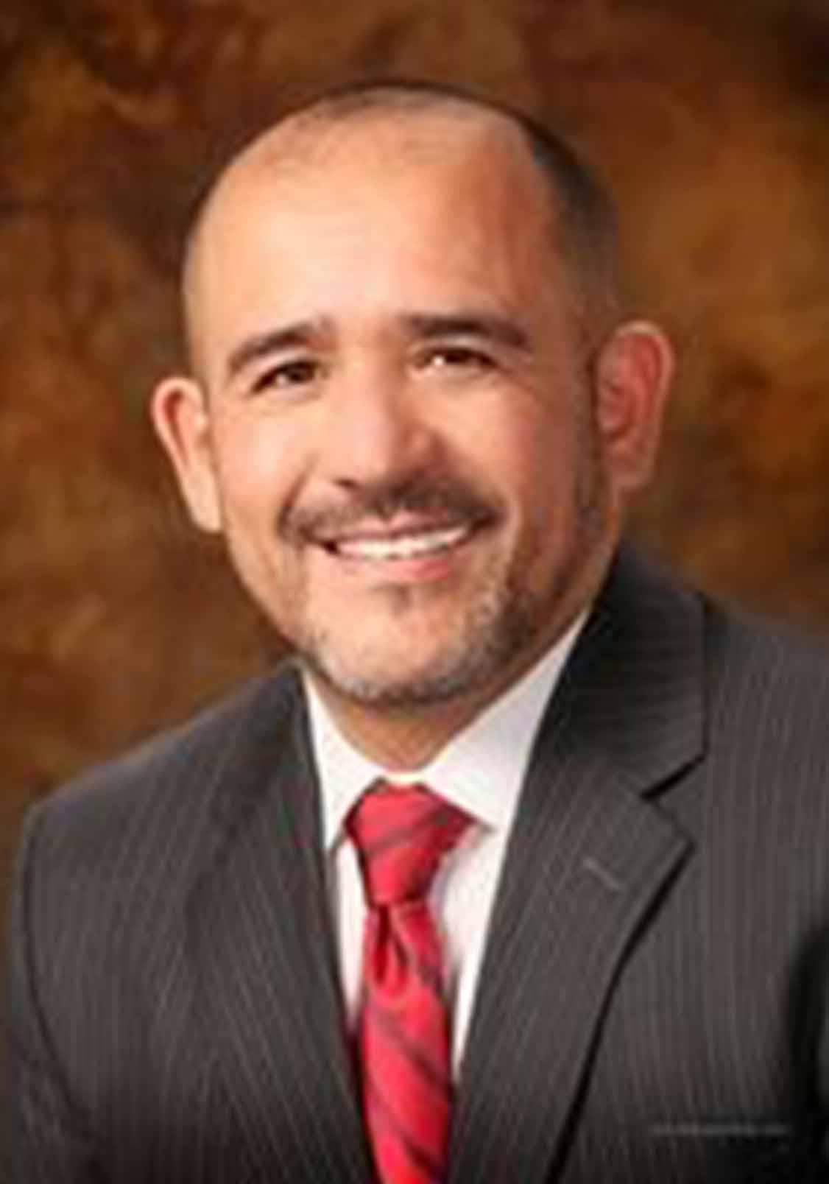
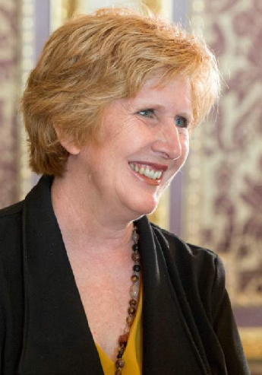
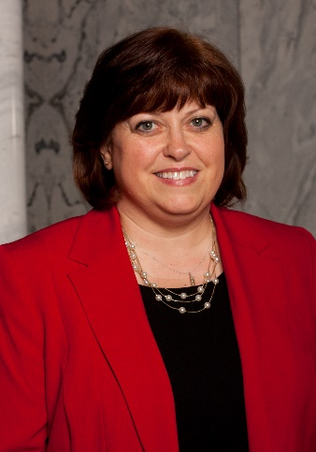
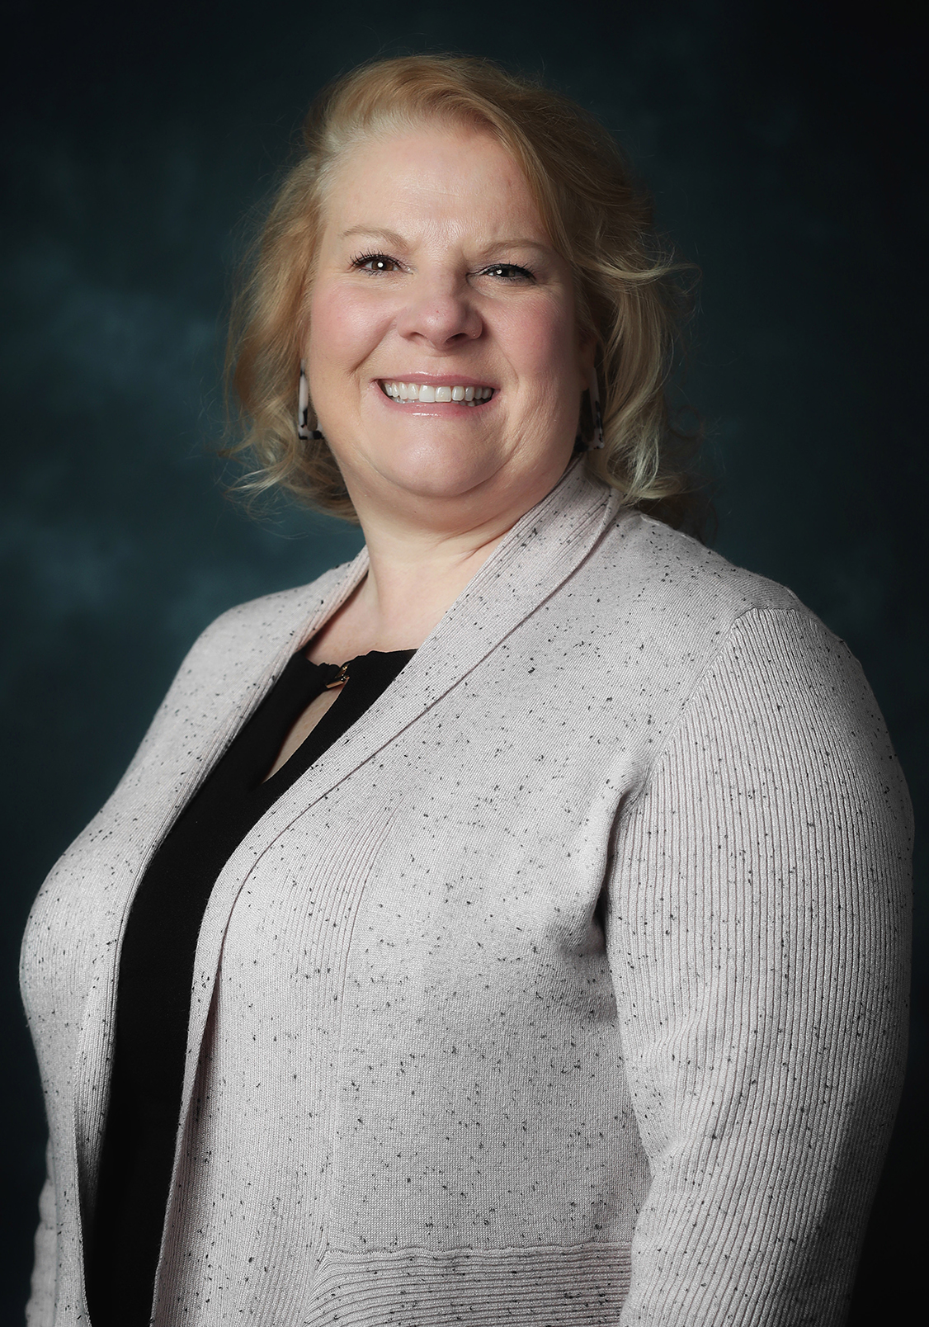
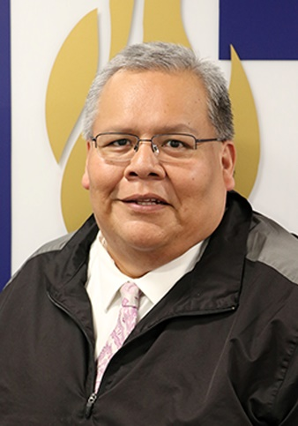
USERVEUTAH
UServeUtah, the Utah Commission on Service and Volunteerism, was created by state statute in 1994 and is comprised of 15-20 members representing local government, community-based organizations, and statewide networks as well as commission staff.
NOT PICTURED:
Melissa Young-Fromm, Forever Young Foundation
David Wolstenholme
Utah Higher Education
Lt. Governor Spencer Cox
Paul Leggett
Salt Lake County
Debbie Hardy
Intermountain Healthcare
Karen McCandless
Community Action Services & Food Bank
David Clark
Zions Bank
Sydnee Dickson
Utah State Board of Education
Alan Griffin
Utah State Board of Education
Debra Hoyt
Dominion Energy
Luis Lopez
Ogden City Councilor
Jill Love
Department of Heritage and Arts
Kelly Riding
Utah Afterschool Network
Judy Watanabe
Emergency Management
Nancy Winemiller-Basinger
Big Brothers Big Sisters of Utah
Brian Yazzie
Provo City School District

Slide 4
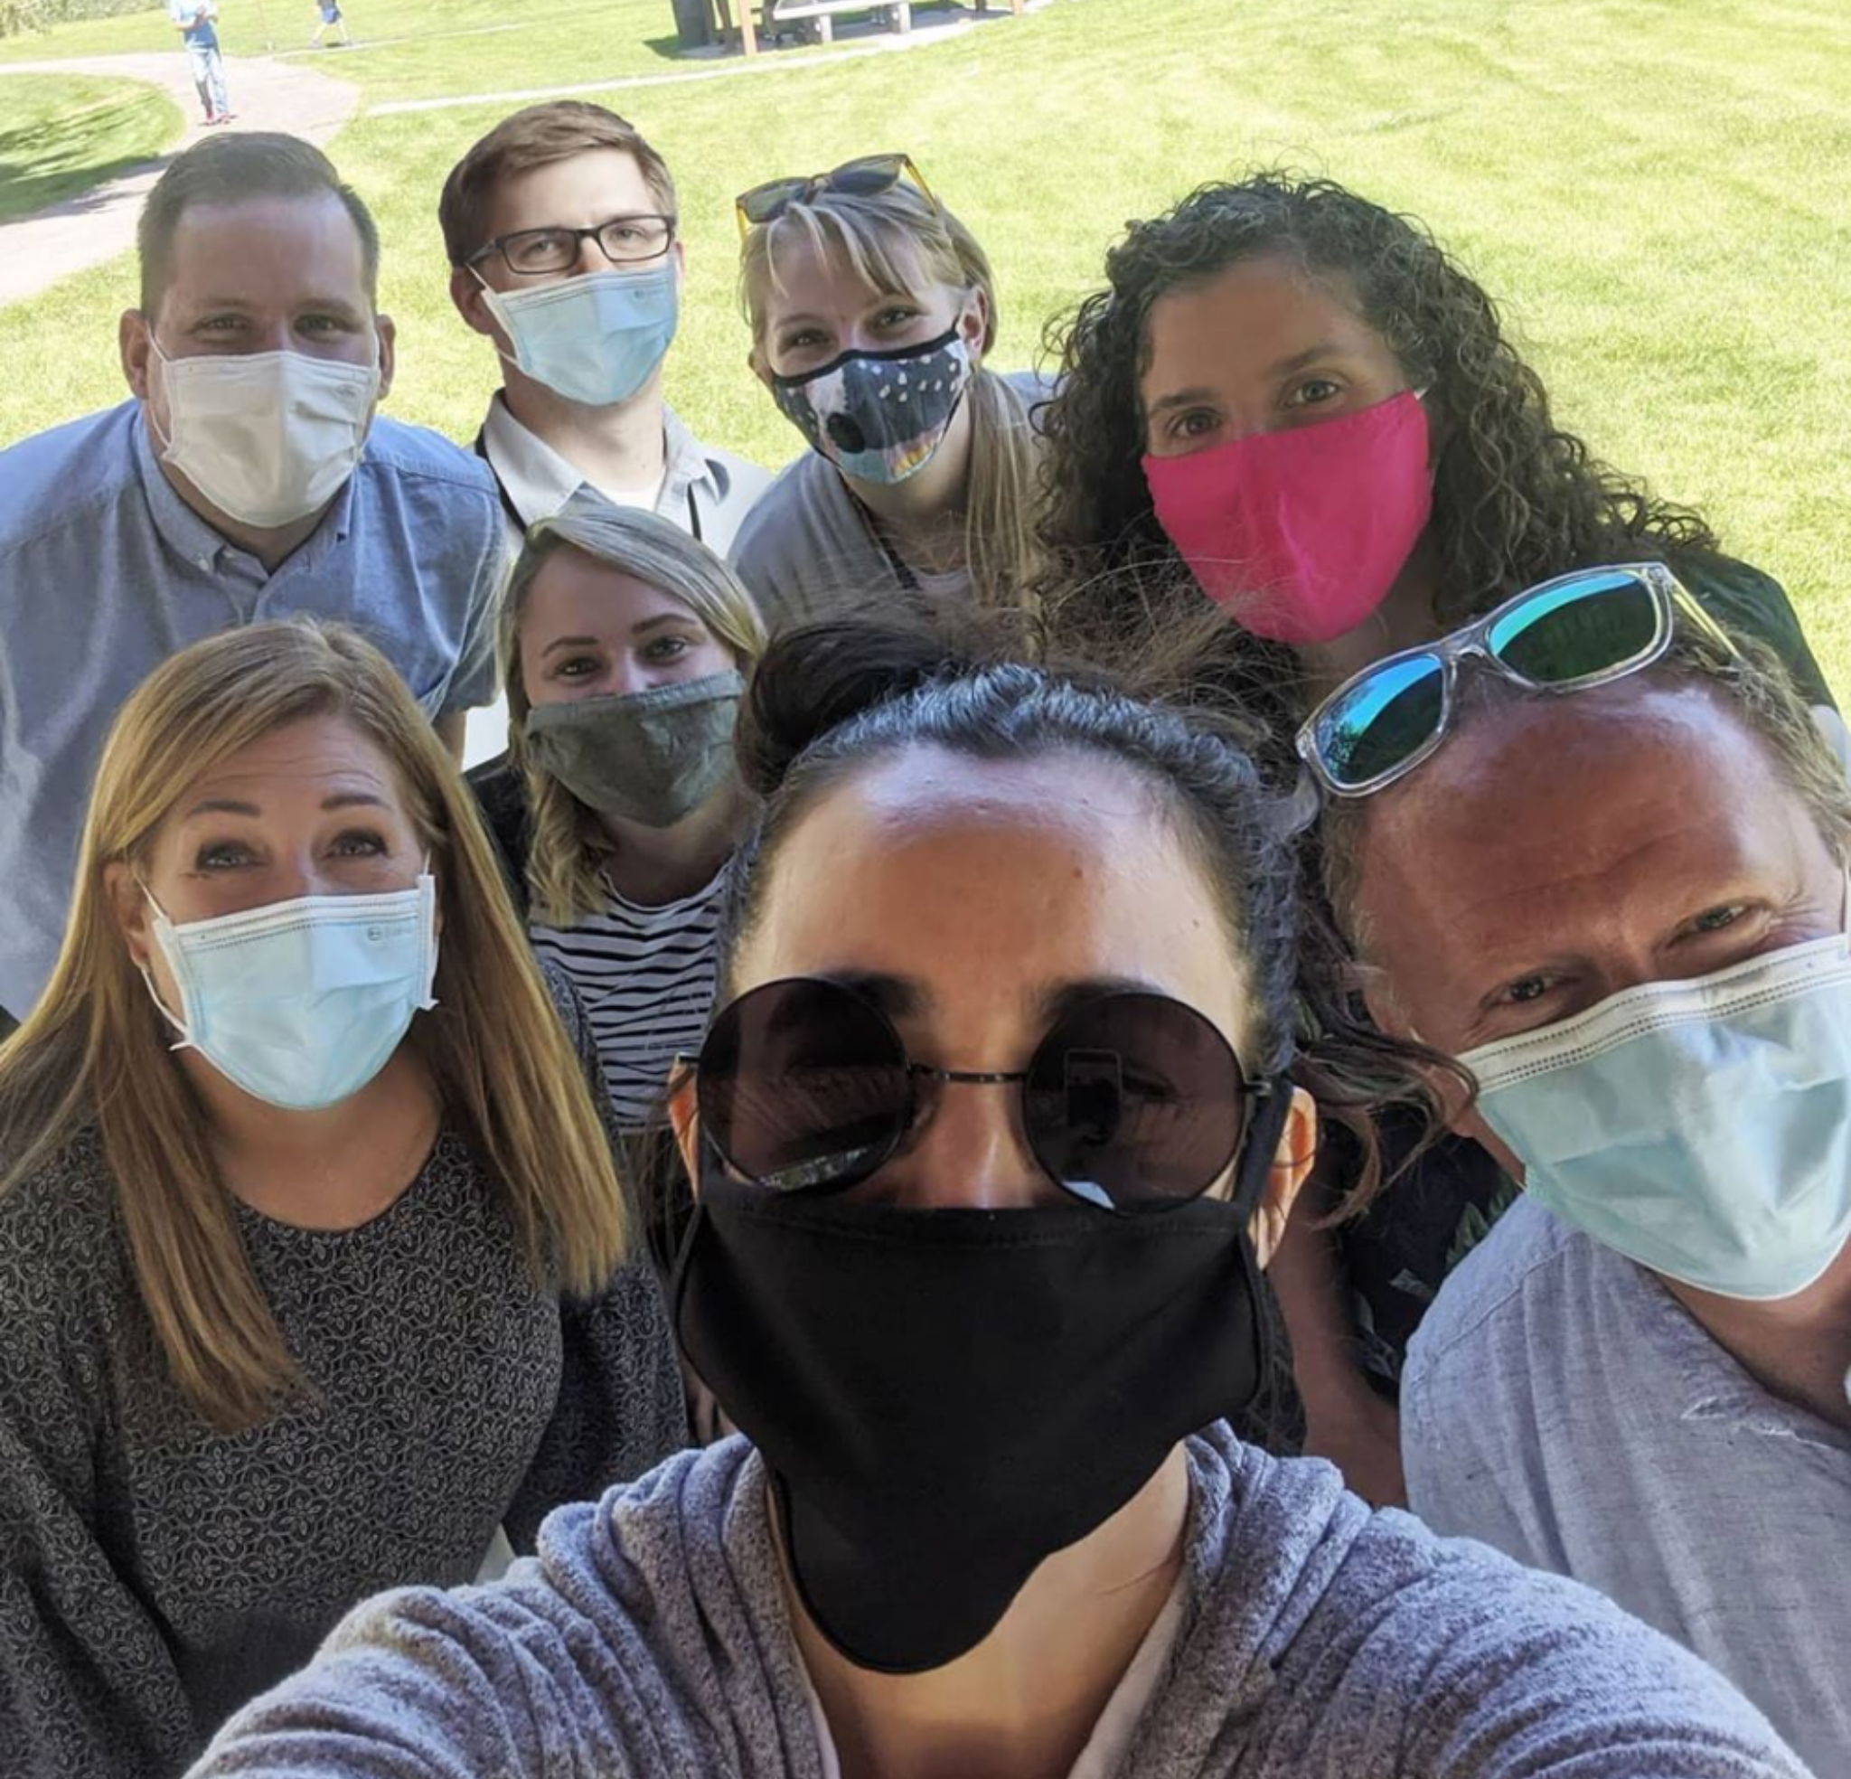
USERVEUTAH
Purpose: As the state’s central coordinating body for service and volunteerism, the Commission is responsible for developing, implementing, and sustaining a vision and culture of national service and community engagement within the state.
Vision: Our vision is to have vibrant, inclusive, productive, communities in Utah with active, engaged individuals.
Mission: Our mission is to strengthen and unify Utah communities through national service, volunteerism, and broader community engagement.

Slide 5
STRUCTURE
(and other state commissions)
AmeriCorps Program
AmeriCorps Program
AmeriCorps Program
AmeriCorps Program
AmeriCorps Program
AmeriCorps Program
AmeriCorps Program
AmeriCorps Program
=
COMMUNITY IMPACT

Slide 6
USERVEUTAH ROLES
Community Engagement
National Service
Provide successful statewide trainings that ensure organizations are prepared for effective community engagement
Support local organizations to recognize effective volunteer efforts
Foster civic engagement and leadership development
Offer pathways to community engagement
Raise awareness of impact of service and volunteerism
Administer grant funding to 14 AmeriCorps programs across UT
Assist programs with administrative, fiscal and programmatic oversight, and training and technical assistance, member development
Lieutenant Governor’s Volunteer Recognition Certificate & other awards
AmeriCorps member recognition
Raise awareness of National Service
Connect members and volunteers to service opportunities

Slide 7
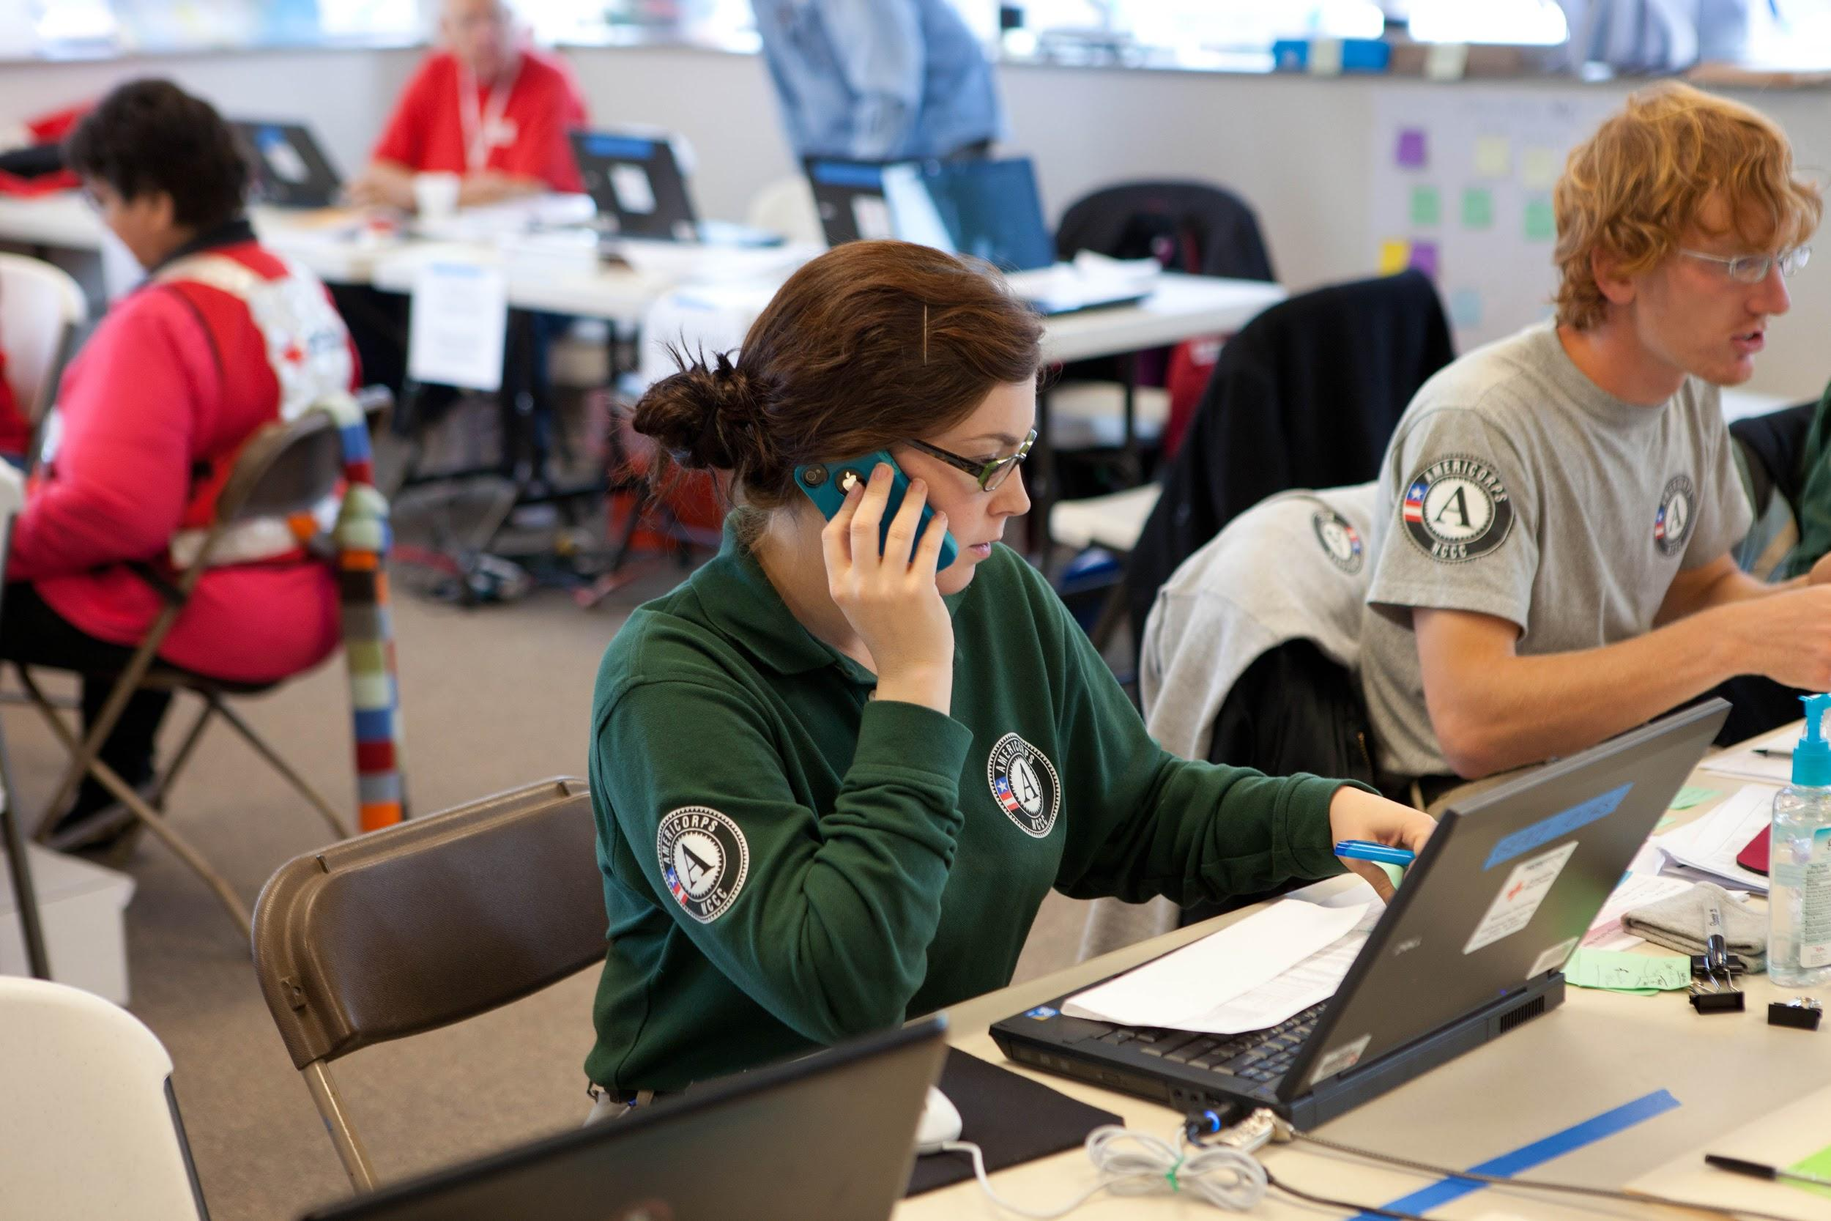
WHAT IS NATIONAL SERVICE TO YOU?
Serving underserved individuals in our country
Filling gaps in community need
Working with communities, individuals, and partners to accomplish goals across nation
Serving with compassion and empathy

Slide 8
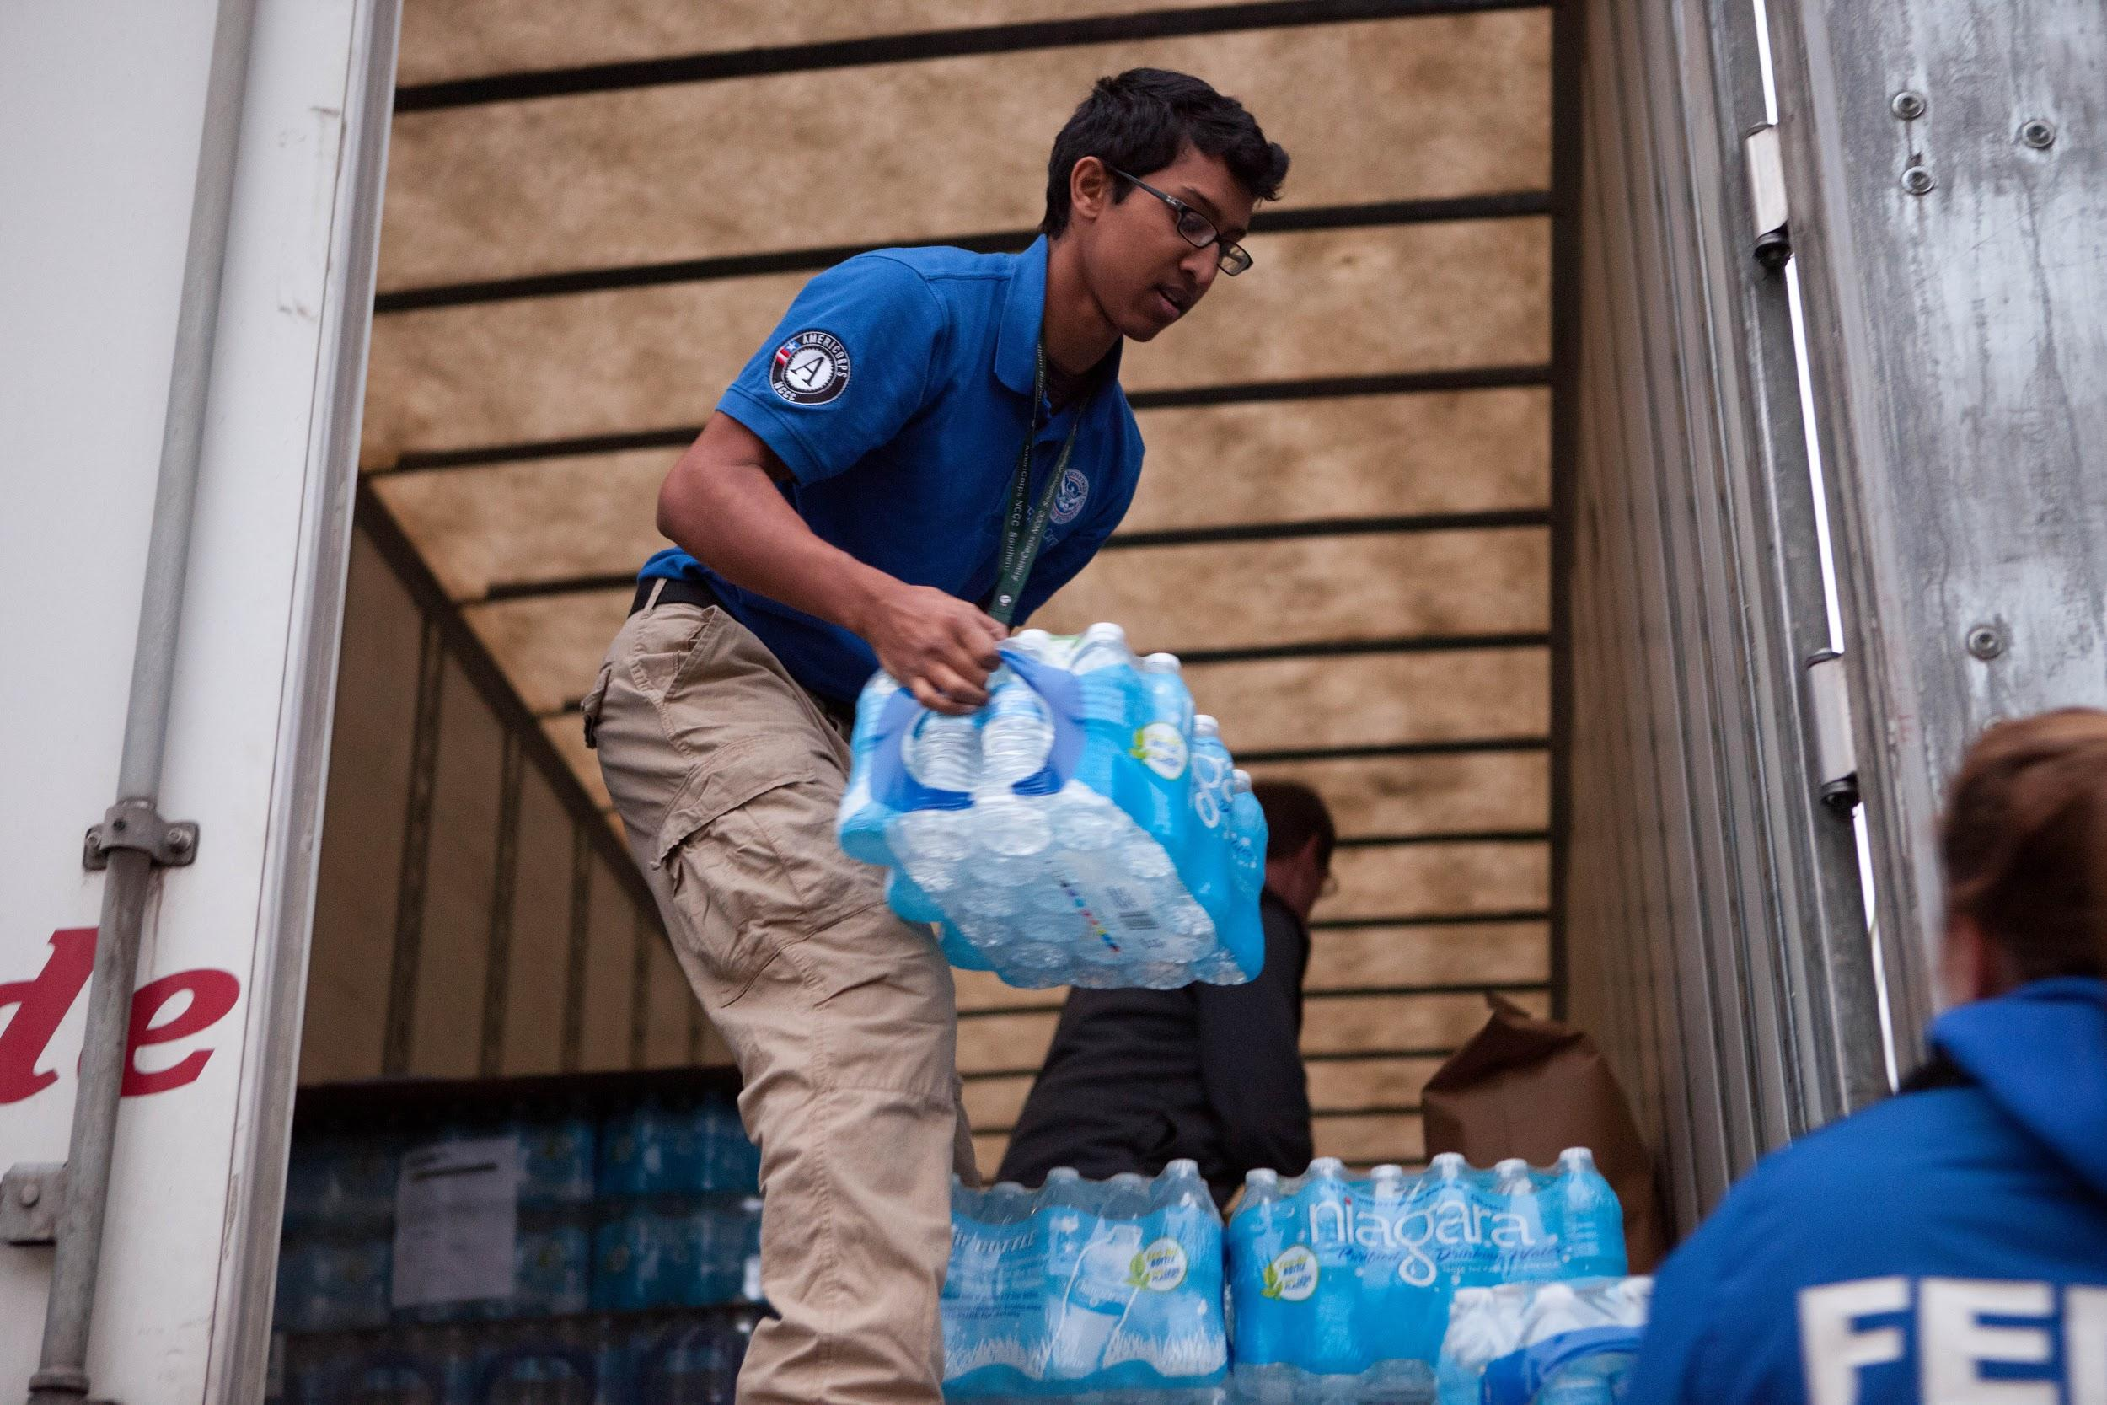
DEFINITIONS OF NATIONAL SERVICE
All the opportunities that exist throughout the country to engage individuals of diverse ages, backgrounds, and abilities in service.
All programs that the Corporation for National and Community Service funds and supports.

Slide 9
BRIEF HISTORY OF NATIONAL SERVICE
1960s
The Retired and Senior Volunteer Program (RSVP), the Foster Grandparent Program, and the Senior Companion Program (National Senior Service Corps) are created.
1964
As part of "War on Poverty," President Lyndon B. Johnson creates VISTA (Volunteers in Service to America), a National Teacher Corps, the Job Corps, and University Year of Action.
1989-1990
President George Bush creates the Office of National Service in the White House.
1933-1942
The Civilian Conservation Corps (CCC) was created by Franklin D. Roosevelt.
1961
President John F. Kennedy and Congress establish the Peace Corps. President Kennedy says, "The wisdom of this idea is that someday we'll bring it home to America."
1970s
Several youth conservation corps created throughout the U.S.
1990
Congress passes, and President Bush signs, the National and Community Service Act of 1990.

Slide 10
HISTORY OF NATIONAL SERVICE CONT’D
September 1994
The first class of AmeriCorps members (20,000 strong) begins serving in more than 1,000 communities.
1990s-2000s
Major growth for AmeriCorps programs in terms of membership, impact, and national recognition.
2009
President Obama signed the Edward M. Kennedy Serve America Act that was passed with bipartisan support.
September 1993
President Bill Clinton signs the National and Community Service Trust Act of 1993, creating AmeriCorps and the Corporation for National and Community Service (CNCS).
1997
AmeriCorps expands by introducing the Education Awards Program.
2003
President Bush creates the President’s Council on Service and Civic Participation. The Council creates the President’s Volunteer Service Award program.

Slide 11
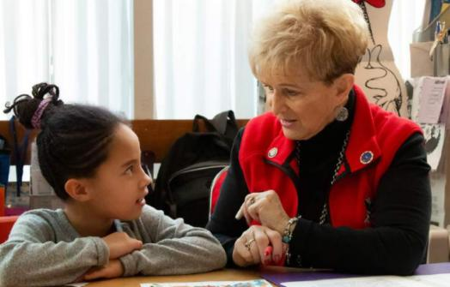
NATIONAL SERVICE
AmeriCorps State & National
Senior Corps
AmeriCorps VISTA
AmeriCorps NCCC
Hands-on experience
Serve within a nonprofit organization or city government
Over 75,000 members
Behind the scenes experience
Anti-poverty focused
Serve within a nonprofit organization or city government
8,000 members annually
Over 220,000 alumni
Direct service
Assigned to a campus
1,200 members
Up to 1,600 FEMA Corps Members
Over 200,000 members age 55+
Includes: Foster Grandparents, Senior Companions, and Retired, Senior Volunteer Program (RSVP)

Slide 12
NATIONAL SERVICE - NOW
2020 - AmeriCorps celebrates 26th anniversary this month
Other notable anniversaries this year
RSVP celebrates 47 years
AmeriCorps VISTA celebrates 55 years
Foster Grandparent Program celebrates 55 years
Senior Companion Program celebrates 45 years

Slide 13
NATIONAL SERVICE IN UTAH (2019)

Slide 14
AMERICORPS PLEDGE
I will get things done for America - to make our people safer, smarter, and healthier.
I will bring Americans together to strengthen our communities.
Faced with apathy, I will take action.
Faced with conflict, I will seek common ground.
Faced with adversity, I will persevere.
I will carry this commitment with me this year and beyond.
I am an AmeriCorps member, and I will get things done.

Slide 15
AMERICORPS GUIDING PRINCIPLES
Compelling community need
Program based in evidence of success and capacity to show impact
Get Things Done
Activities that address the need
Demonstrate impact & evidence of success

Slide 16
AMERICORPS GOALS
Meeting social & community needs
Responding to natural & other disasters
Strengthening nonprofits & faith-based groups
Advancing innovative solutions
Harnessing the power of American citizens
Creating future leaders

Slide 17
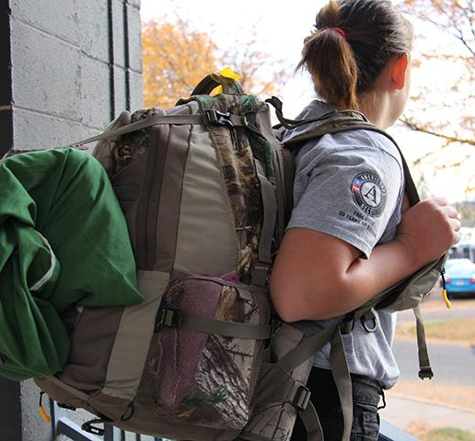
AMERICORPS FOCUS AREAS
Healthy Futures
Education
Disaster Services
Economic Opportunity
Environmental Stewardship
Veterans and Military/Families
Local Priority Areas

Slide 18
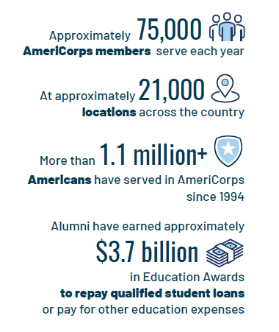
AMERICORPS STATS

Slide 19
AMERICORPS BENEFITS
Professional Development
Sharpen your skills and bolster your resume.
End of Service Award
Earn a Segal AmeriCorps Education Award to pay for current education expenses, and to repay qualified student loans.
Living Allowance
Receive a modest bi-weekly living allowance to cover basic expenses.
Jobs with Leading Employers
Connect to a network of employers from all sectors who value AmeriCorps experience.
Health Benefit
Some AmeriCorps programs offer limited health benefits.
And many more benefits...

Slide 20
BENEFIT OF SERVICE
“I will get things done for [Utah]- to make our people safer, smarter, and healthier.
I will bring [Utahns] together to strengthen our communities…”

Slide 21
KEY TAKEAWAYS
National service
is really cool!
is needed
makes a tremendous impact on local communities and organizations
You
are also really cool!
are needed
make a tremendous impact on local communities and organizations
You are the lifeblood of national service

Slide 22
REFLECT
As an AmeriCorps member, what impact do you hope to have through national service?
Goals
Overcome obstacles
Utilize this opportunity
Share your journey

Slide 23
ANY QUESTIONS?

